Slide 1
Entry requirements
A general interest in science is required!
Grade 4/5 or above in English Language. You need to be able to write in a clear, coherent style to explain the theory and get your ideas across.
Two Grade 5s in GCSE Science. Students that achieve below this grade will struggle with the academic section of the course.
Grade 4/5 or above in maths: You need to be able to do basic calculations and convert values.
Notes:
For students who like science but don’t want to do a separate A level/ option clashes/ good general option or didn’t get 6s Possibly take 4s for science if keen enough and prepared to work

Slide 2
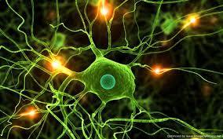
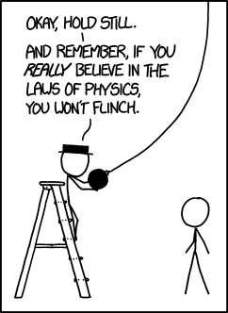
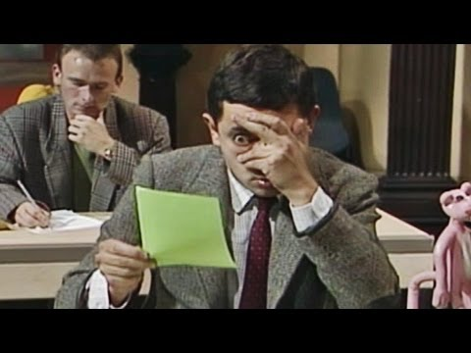
Y12 Applied Science
Unit One: Principles and
Applications of Science
Notes:
Theory based with an exam

Slide 3
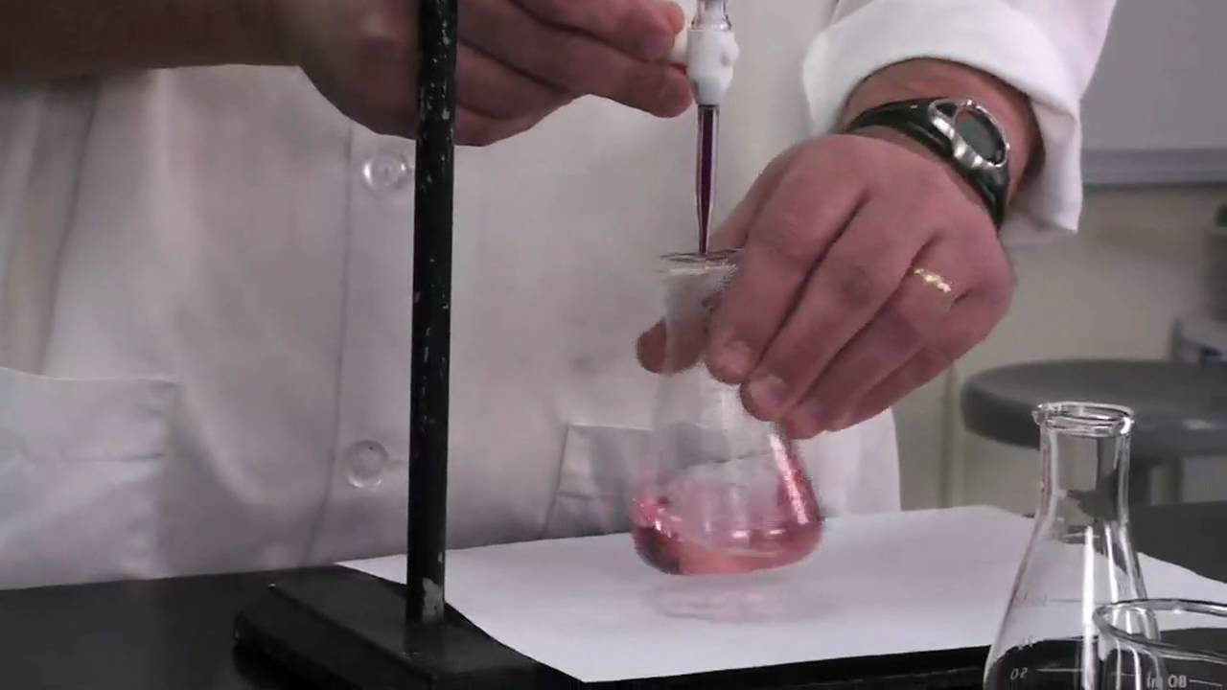
Y12 Applied Science
Unit Two: Practical Scientific Procedures and Techniques
Notes:
4 assignments. In Y13 a practical exam and coursework (optional unit choice based on student preference)

Slide 4
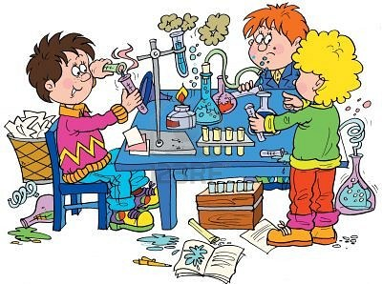
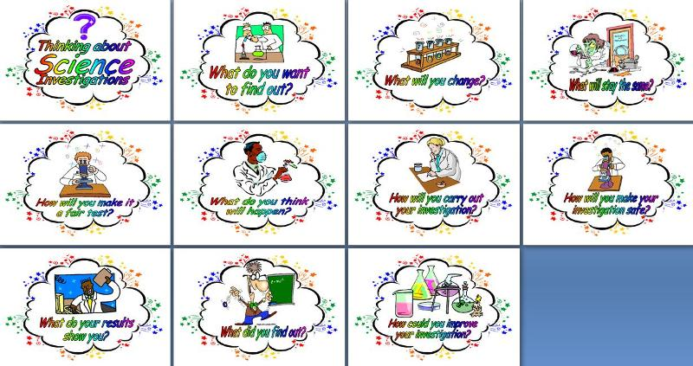
Y13 Applied Science
Unit Three: Science Investigation Skills
Notes:
In Y13 a practical exam lots of practicals and a bit of theory

Slide 5
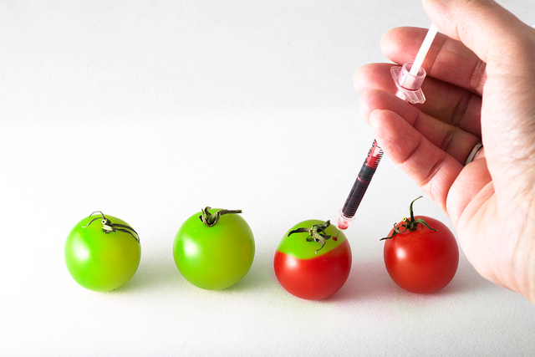
Y13 Applied Science
Optional Unit: 4 assignments similar to Unit 2 in expectations
Notes:
coursework (optional unit choice based on student and teacher preference) This year doing a unit on genetics

Slide 6
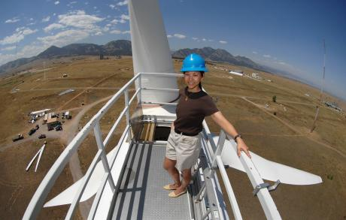
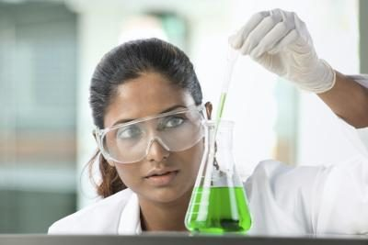
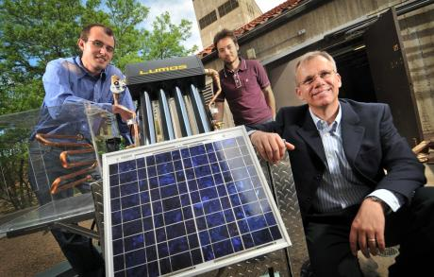
Where will Applied Science take you?
Degrees and employment: Science related degrees in FE or an extra qualification where you just need “points” Apprenticeships;
Practical based careers including researching, designing and developing new products and processes.
A focus on employability skills – the BTEC approach to learning, through projects, self-directed assignments, group work and exams has
always supported the development of employability skills.
Future prospects: You might be based in a hospital, laboratory, university, factory or office. There are many large science companies, as well as small, specialist businesses.
Notes:
Most of our students go on to university- including unconditional offers! Previously a mix of university eg paramedics/ nursing or jobs such as Police force and apprenticeships

Slide 7
“It’s easier than biology”
“It’s a nice range of all three sciences”
“More relaxed and takes the pressure off a bit”
“I enjoyed it more than I thought I would!”

