Slide 1
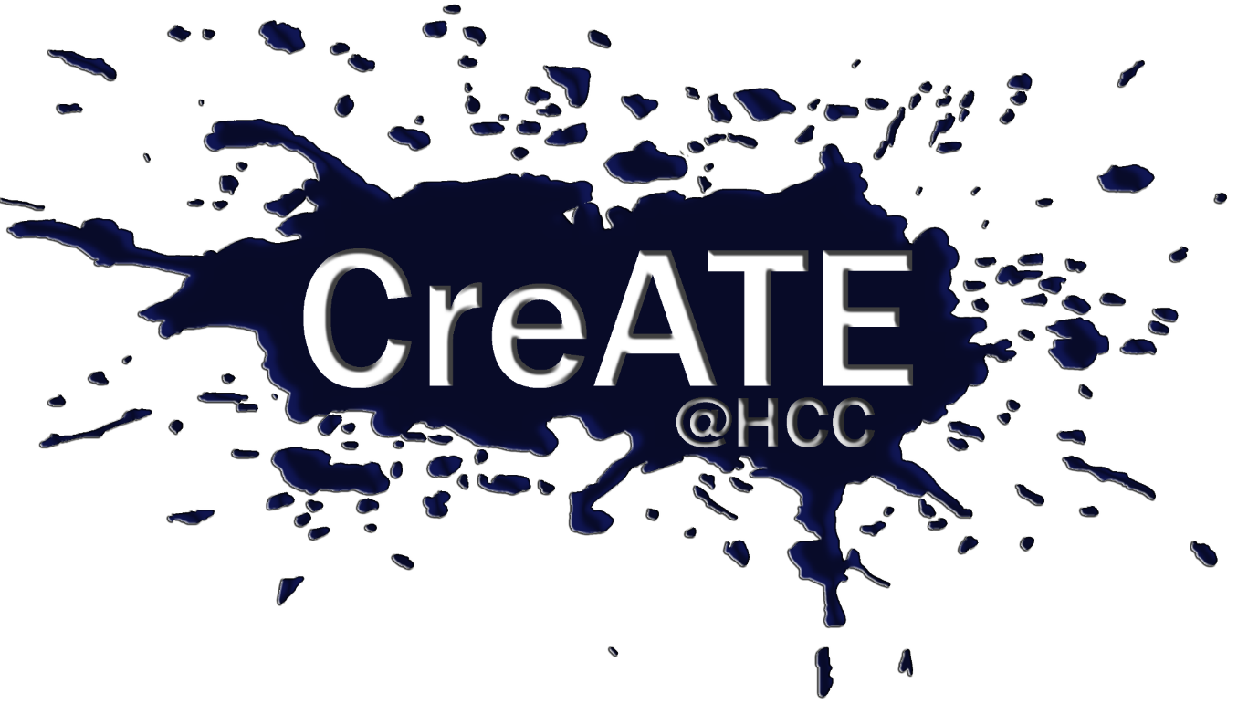
OVERVIEW
A Level Fine Art
A Level Photography
Exam Board: Edexcel

Slide 3
Where can Fine Art and Photography lead?
Transferrable Skills
Destinations
Destinations
Technical skills
Composition, editing, selection, refinement, creativity
Arts/Sculpture/Photography Degrees
Practical and theoretical higher study
Arts/Fashion/Graphics/Illustration/Photography/ Marine Photography Degrees
Practical and theoretical higher study
Critical judgement and analysis
Opinion forming and making informed judgements
Fashion/Interior Design/Architecture Degrees
Practical and theoretical higher study
Journalism and Advertising
Magazine, newspaper, e-media, photographer
Independent ideas development
Identifying and selecting appropriate sources
Foundation Course
Explore a range of Art/Design options
Foundation Course
Explore a range of Art/Design options
Project management and presentation
Being inspired, deadlines, presenting work
College Course in Arts
To prepare for working within the arts
College Course in Photography
To prepare for working as a photographer
Cultural awareness
Understanding and appreciation of visual culture
Illustration, Graphics Courses including Degrees
Games design, illustration, graphic design
Film maker
Working with film, documentary, travel, arts
Observation
Attention to detail, ability to illustrate ideas
Museums, Education
Becoming a lecturer or teacher, working with museums
Museums, Education
Becoming a lecturer or teacher, working with museums

Slide 4
Fine Art Coursework
Photography Coursework
Practical Exam
60% of A-Level
60% of A-Level
40% of A-Level
Skill building projects, Individual project, Personal Study
Includes:
Composition
Location and gallery visits
Painting
Printmaking
Drawing
Three dimensions
Digital manipulation
Developing an idea
Analysing the work of other artists
Presentation techniques
Skill building projects, Individual project, Personal Study
Includes:
Camera controls
Composition
Location and gallery visits
Studio lighting
Digital imaging
Manual film photography and darkroom printing
Developing an idea
Analysing the work of other artists
Presentation techniques
Starting Point set by Edexcel
Students develop their own projects with staff support from the exam starting point across a 10 week period.
The final 15 hour practical exam gives students a sustained period of time to complete their outcomes based on the development they have made from the exam board’s starting point.
Requires independence, creativity, applying skills, planning and refining ideas.
Requires regular practice and development of practical skills.
Requires regular practice and development of practical skills and regular access to a camera.

Slide 5
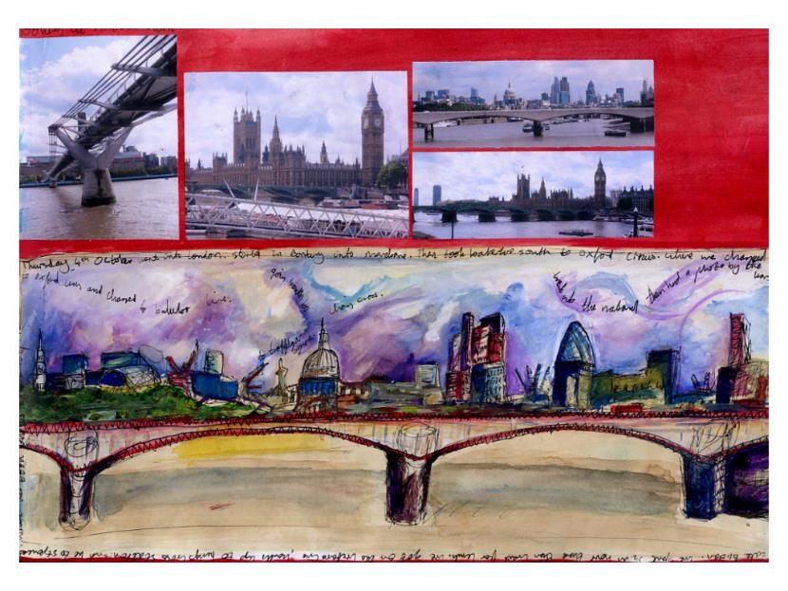
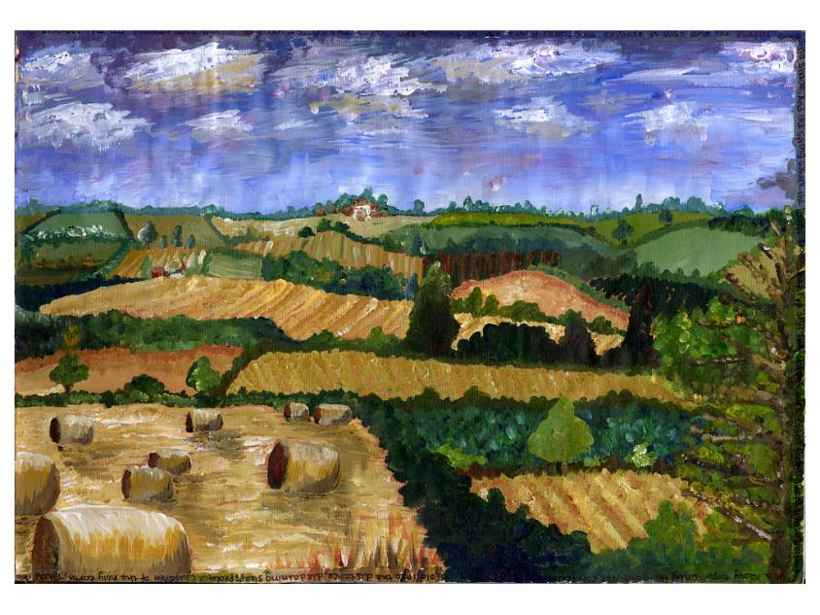
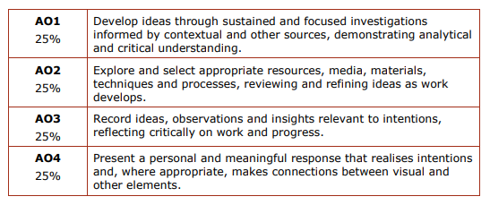
Coursework Details

Slide 6
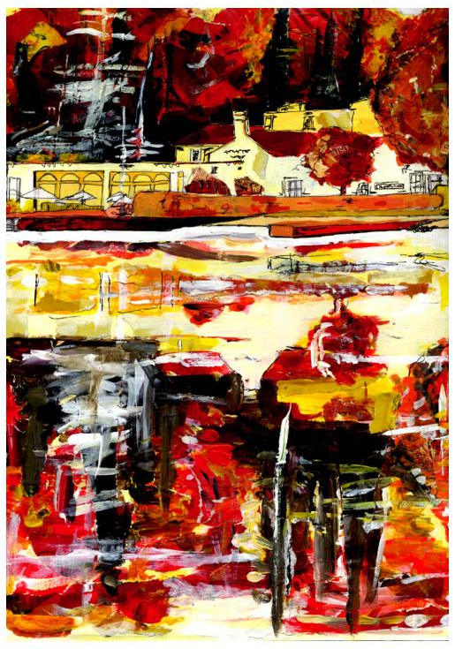
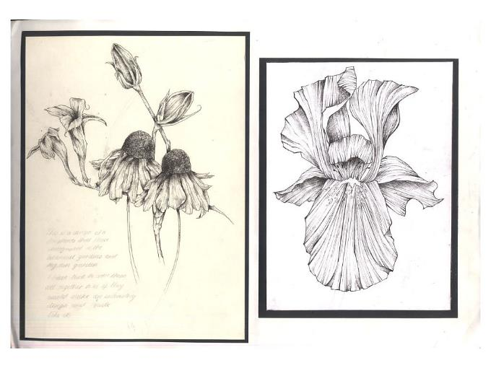
Coursework Details

Slide 7
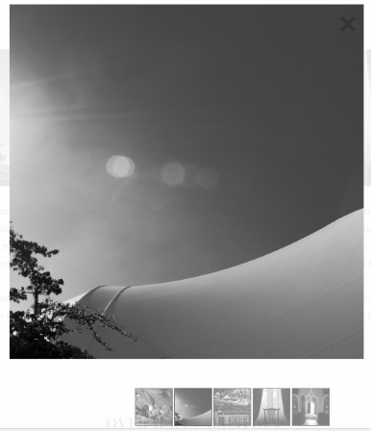
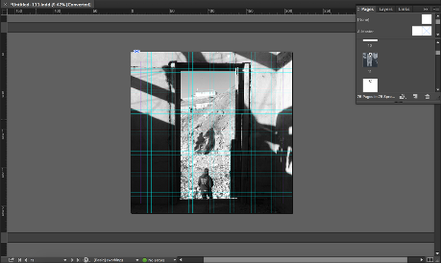
Coursework Details

Slide 8
Fine Art Coursework
Photography Coursework
Practical Exam
60% of A-Level
60% of A-Level
40% of A-Level
Skill building projects, Individual project, Personal Study
Includes:
Composition
Location and gallery visits
Painting
Printmaking
Drawing
Three dimensions
Digital manipulation
Developing an idea
Analysing the work of other artists
Presentation techniques
Skill building projects, Individual project, Personal Study
Includes:
Camera controls
Composition
Location and gallery visits
Studio lighting
Digital imaging
Manual film photography and darkroom printing
Developing an idea
Analysing the work of other artists
Presentation techniques
Starting Point set by Edexcel
Students develop their own projects with staff support from the exam starting point across a 10 week period.
The final 15 hour practical exam gives students a sustained period of time to complete their outcomes based on the development they have made from the exam board’s starting point.
Requires independence, creativity, applying skills, planning and refining ideas.
Requires regular practice and development of practical skills.
Requires regular practice and development of practical skills and regular access to a camera.

Slide 9
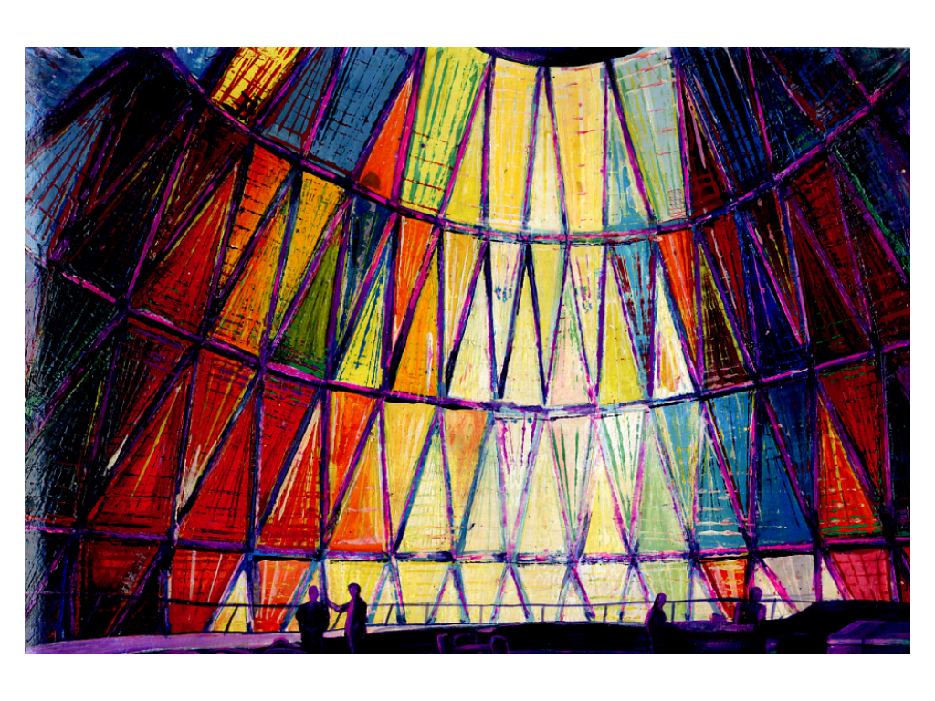
Detail from A level Exam piece

Slide 10
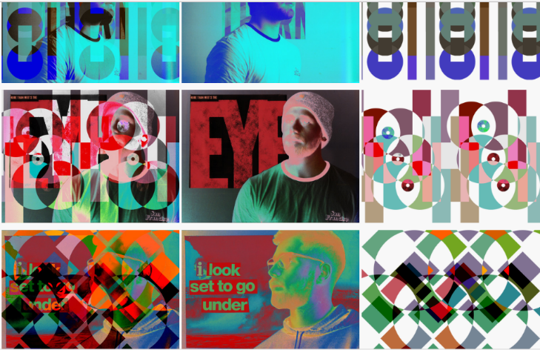
Detail from A level Exam piece

Slide 11
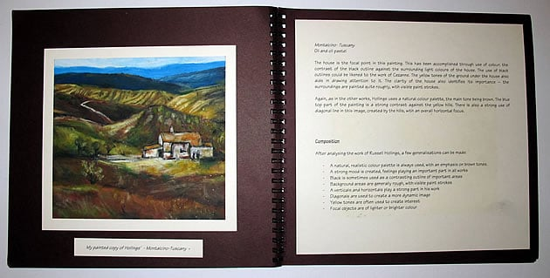
Personal Study
Illustrated essay
Focus on a specific artist/photographer or art movement (or alternatively, a concept or artifact).
Be related to your own investigations and practical (course)work.
Include supporting images - from your chosen focus, your own work, and relevant wider connections.
Include a bibliography
Be informative, insightful and provide a personal perspective.
Notes:
Be a well-presented labour of love; a pleasure for others to pick up and read.

Slide 12
Personal Study
What could yours be about?
Identity?
Power?
Climate Change and art?
Moral messages?
Propaganda and persuasion?
Art informing fashion?
​INTRODUCTION EXAMPLE 1 I am fascinated with themes of identity. In particular I am interested in what 'identity' might mean to a portrait artist, and how they might set out to understand and capture a person's identity. Grayson Perry, contemporary artist, forms a main focus for this essay. His TV documentary "Who Are You?" has been a big influence on my work this year. After watching this series I found myself reflecting on how I might create a portrait that goes beyond simplistic observations to capture a stronger sense of identity.

Slide 13
Key Summary
No written exam
the Art/Photography courses are assessed practically (60% coursework, 40% practical exam)
Year 12 begins with a skill building ‘foundation’ course
Then students set their own projects for the final coursework and personal study.
Personal Study – 1000 -3000 words
Written study completed within coursework to link to the student’s chosen subject matter. This is completed in sections with support from teachers.

Slide 14
Course Requirements
Students usually enter the course with a 5 or above in a GCSE Art subject (Fine Art, Photography. 3D Design).
Enthusiasm is essential – see Art staff to discuss if you are keen but don’t have the required Arts at GCSE.
Photography: you will need to use a camera (not only a camera phone) on a regular basis for this course.

