Slide 1
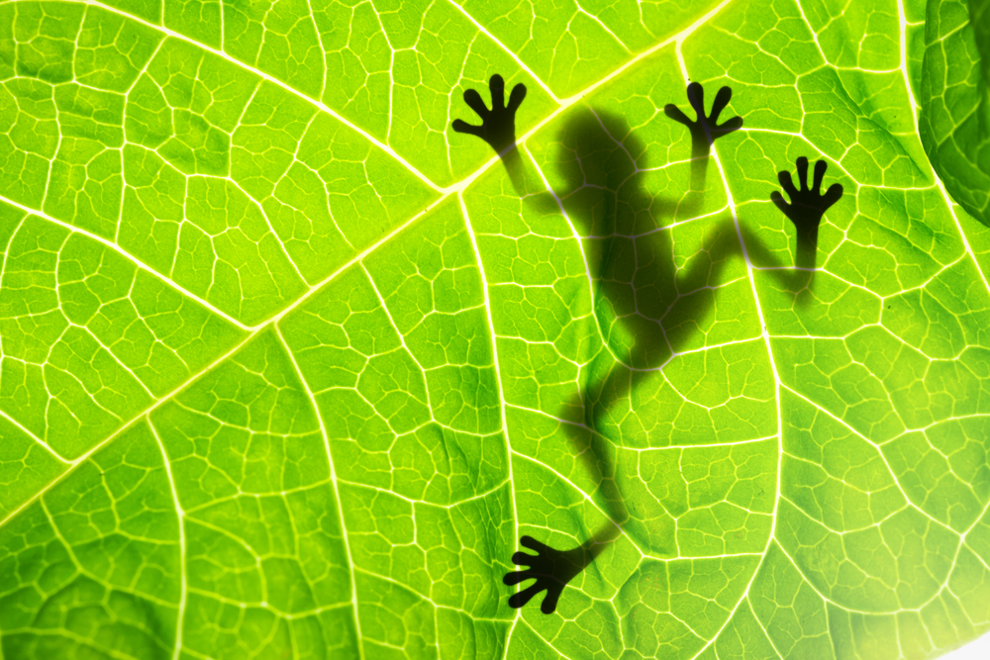

Slide 2
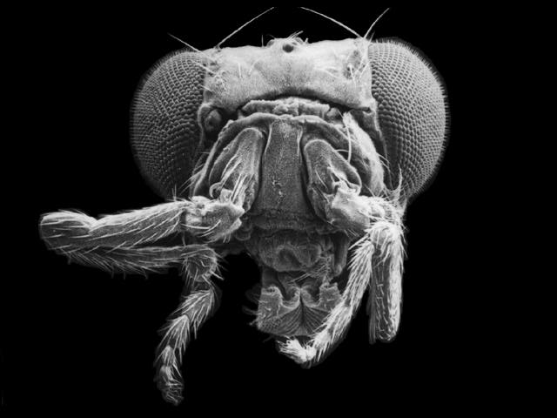

Slide 3
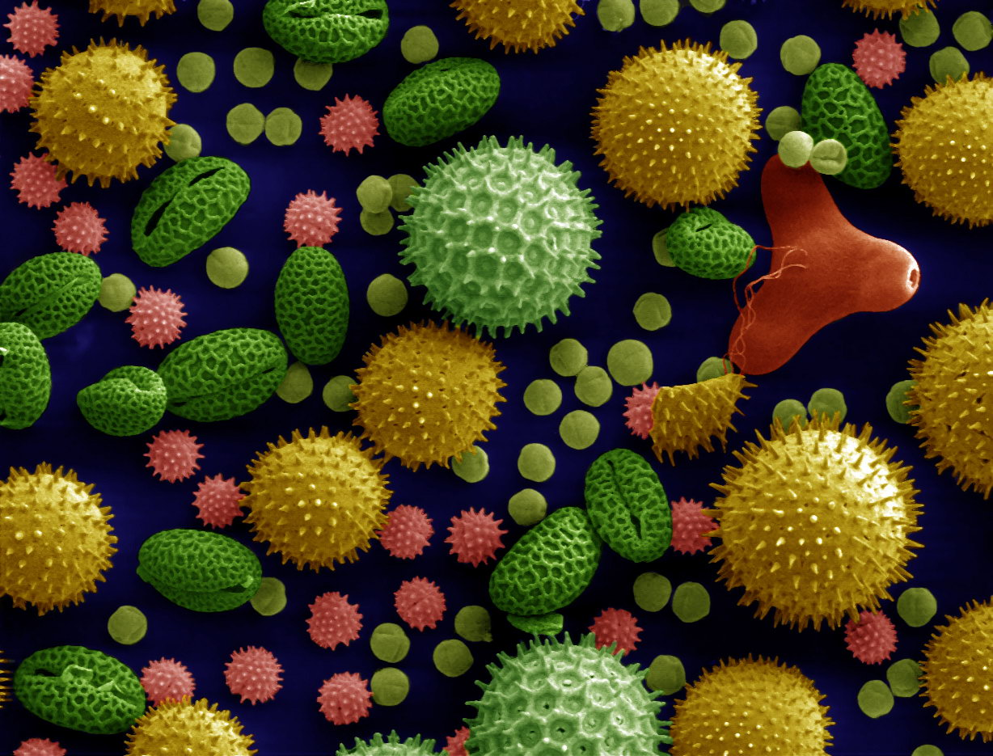

Slide 4
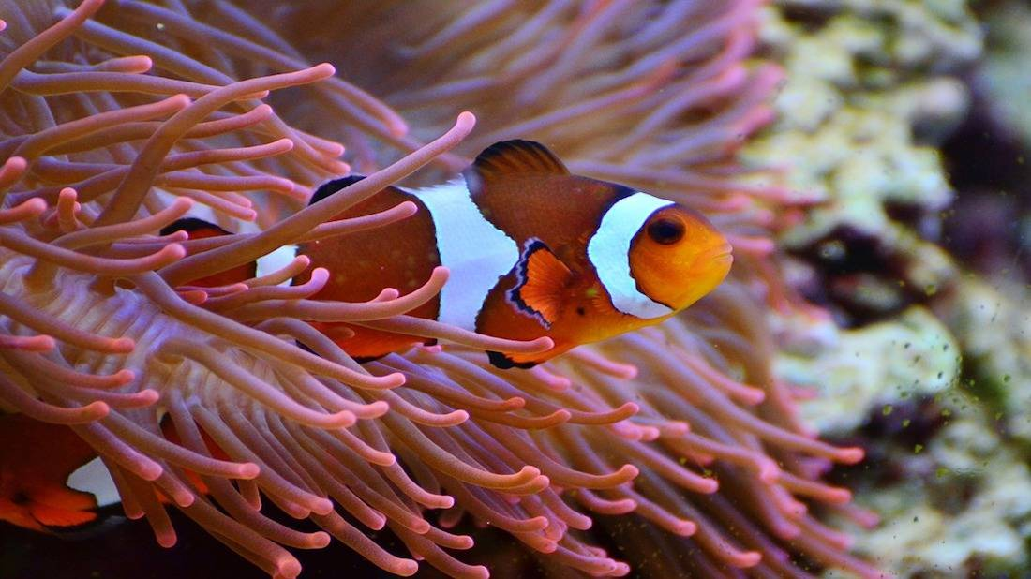

Slide 5
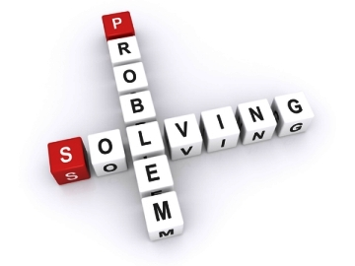

Slide 6
Why Biology?
"It seems to me that the natural world is the greatest source of excitement; the greatest source of visual beauty; the greatest source of intellectual interest. It is the greatest source of so much in life that makes life worth living.“
David Attenborough
Rachel Lambert-Forsyth, CEO of the British Pharmacological Society, says: “Biology opens up exciting career possibilities. From conservation to cancer research, biologists are tackling important 21st century challenges, and we need skilled young people to be part of this.”

Slide 7
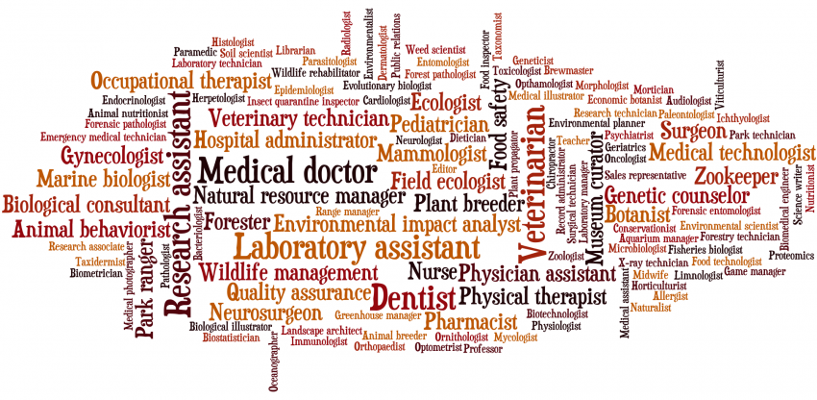
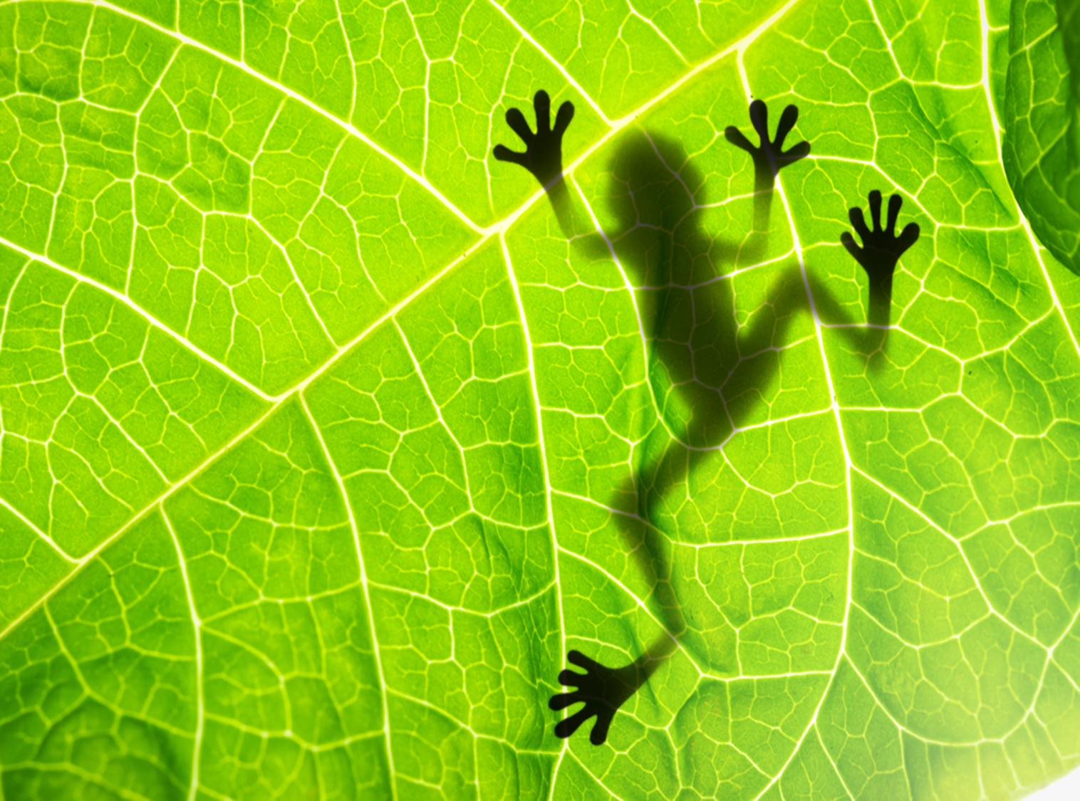

Slide 8
What subjects go with Biology?
Biology will support your study of other sciences and Maths as well as subjects like Psychology and Geography. But study it with a language or an essay subject like English at A-level and you might have even more choices for your career.

Slide 9
What will you study?
Year 12
1 Biological molecules
2 Cells
3 Organisms exchange substances with their environment
4 Genetic information, variation and relationships between organisms
Year 13
5 Energy transfers in and between organisms
6 Organisms respond to changes in their internal and external environments
7 Genetics, populations, evolution and ecosystems
8 The control of gene expression

Slide 10
Assessment

Slide 12
Biology at HCC?
“I got a 6 sir!”
“Less intimidating, feel smarter!”
“We really enjoy it”
“It tells you everything about yourself”
“Interesting”
“Smaller classes”
“Knowing the teachers”
“More personal”
“It’s fun!”
“More at ease, less distractions” “More 1:1 help”

