Slide 1
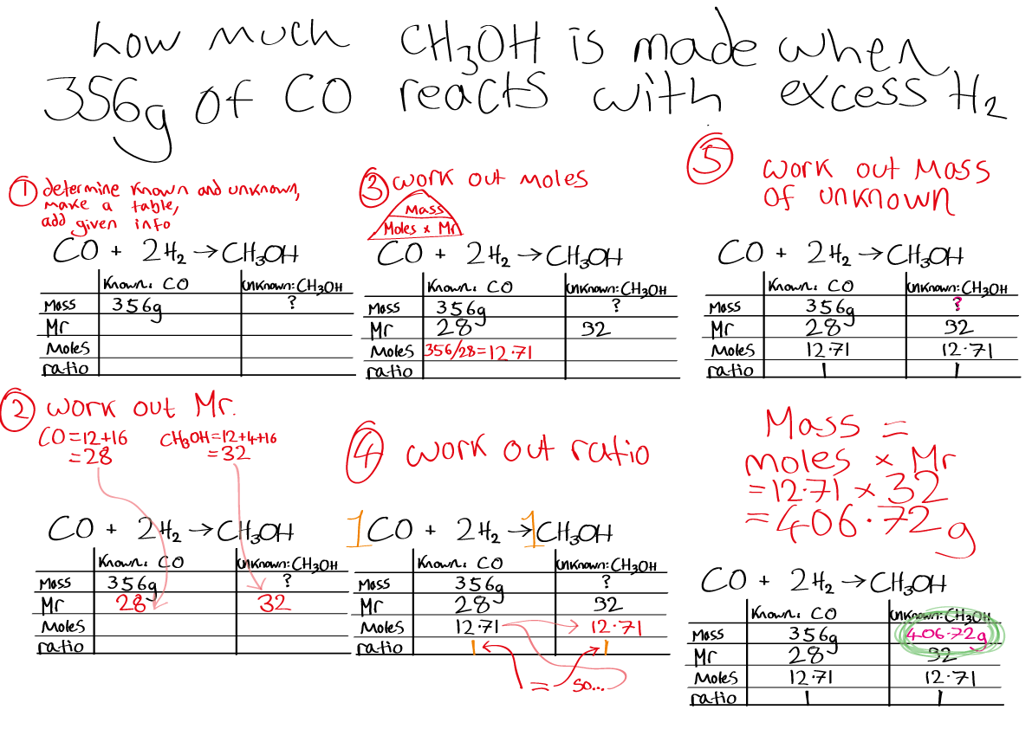
Entry Requirements
A-Level Chemistry
Grade 6 and above in:
GCSE Trilogy Science
GCSE Chemistry
Students that achieve below this will struggle with the academic rigour of the subject.
Grade 5 or above in Mathematics
Being able to carry out calculations is essential for certain topics in the course.
An interest in topical scientific developments will ensure that you keep up to date with topics that may be referenced in exams. Being able to link what you are studying with real world examples will bring the course to life.

Slide 2
A-Level Chemistry
The course is split into 6 modules:
Development of practical skills in chemistry.
Chemistry is a practical subject and the development of practical skills is fundamental to understanding the nature of chemistry.
Foundations in chemistry
A bridge between GCSE and A-level.
Explains the basics that all chemistry is built upon.
Periodic table and energy
Applies the theory of chemistry to real life situations.
Why do chemical reactions occur and how do we control their speed and how much is made?
Core Organic Chemistry
Introduces the chemistry of life and applies it to everyday life.
Physical chemistry and transition elements
Deeper understanding of the chemistry of chemical reactions.
What affects the speed of a chemical reaction? Will a reaction even happen?
Organic chemistry and analysis
Further types of organic compounds,how we can move from one to another and how can we determine the structure of a compound?

Slide 3
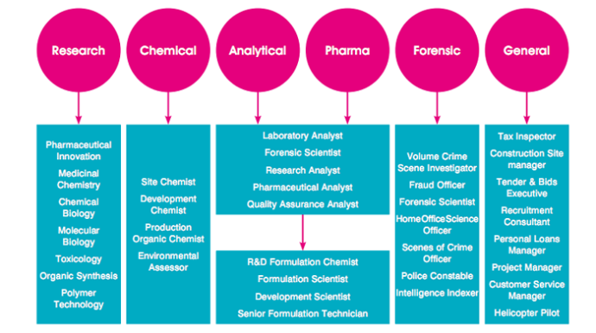
Where Chemistry can take you

