Slide 1
A Level Computer Science
Overview

Slide 2
“Britain has seen an exponential growth in digital innovation, but the shortage of digital skills is threatening to derail the UK’s position as a dominant force in IT. The UK, at any one time, is facing a shortfall of around 40,000 people with the necessary STEM skills to meet the demand of the digital economy.
The British Chamber of Commerce released a study which highlighted that 75 percent of UK businesses reported a digital skills shortage in their employee base.”

Slide 3
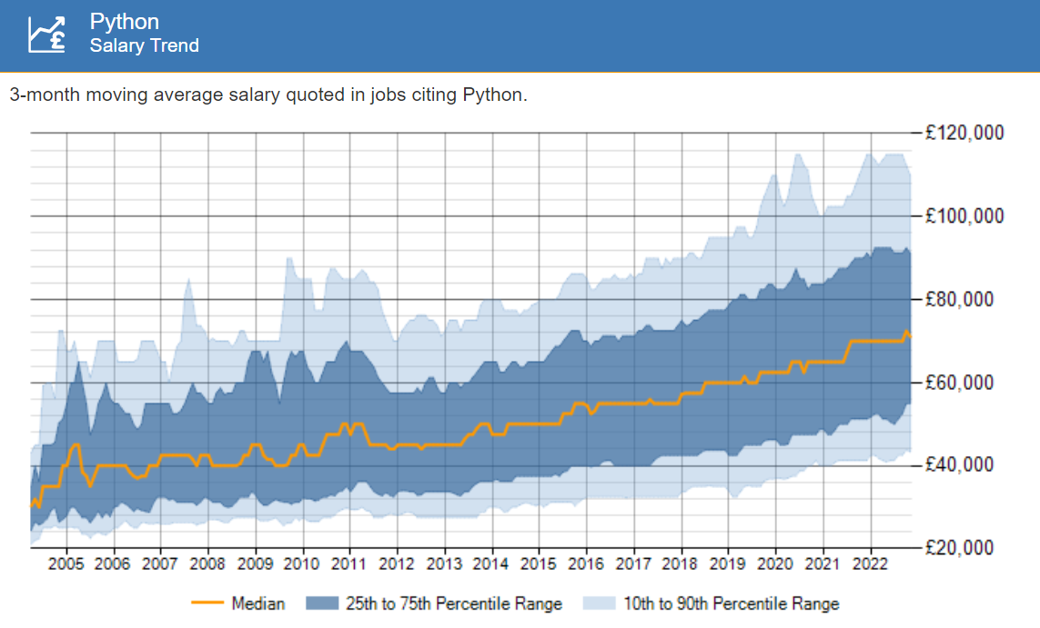

Slide 4
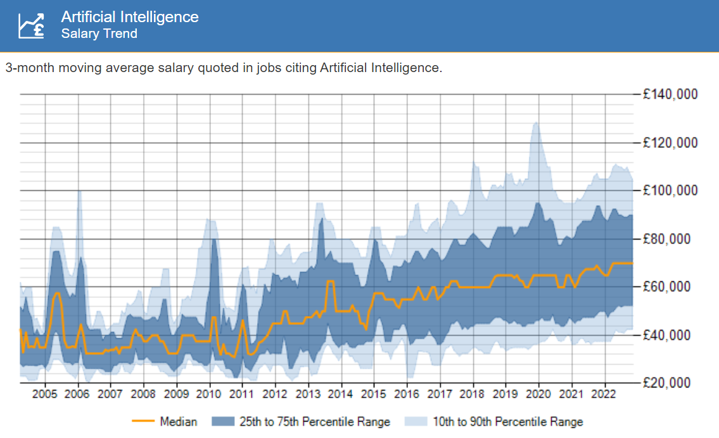

Slide 5
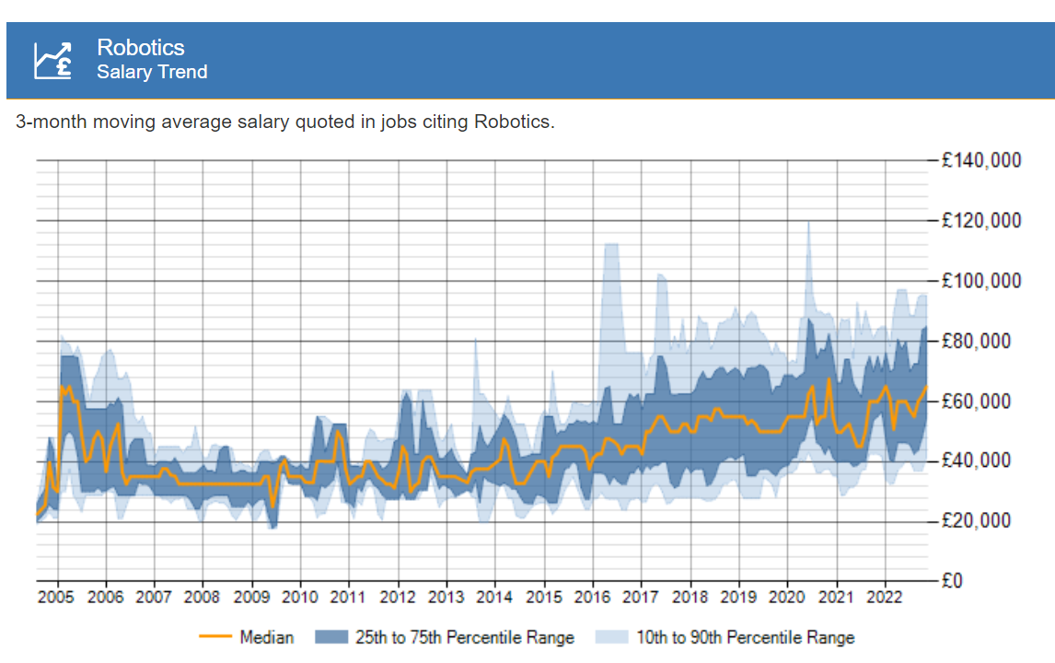

Slide 6
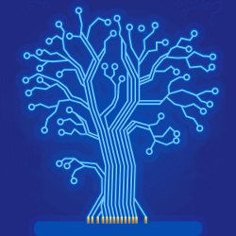
Challenging
Problem Solving
Crosses Subject Boundaries
Maths, Science, Humanities
Human Achievement

Slide 7
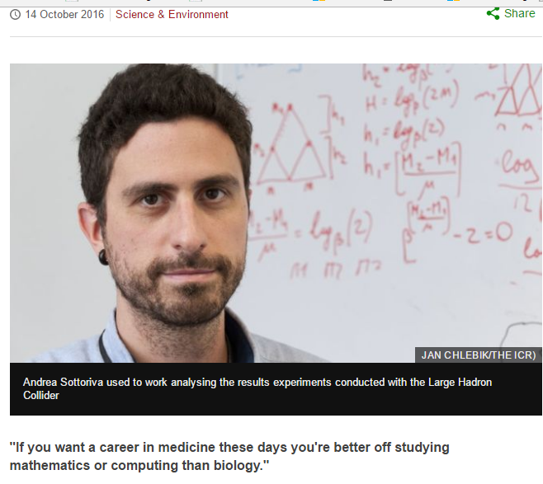
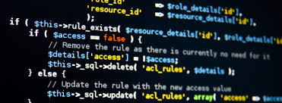
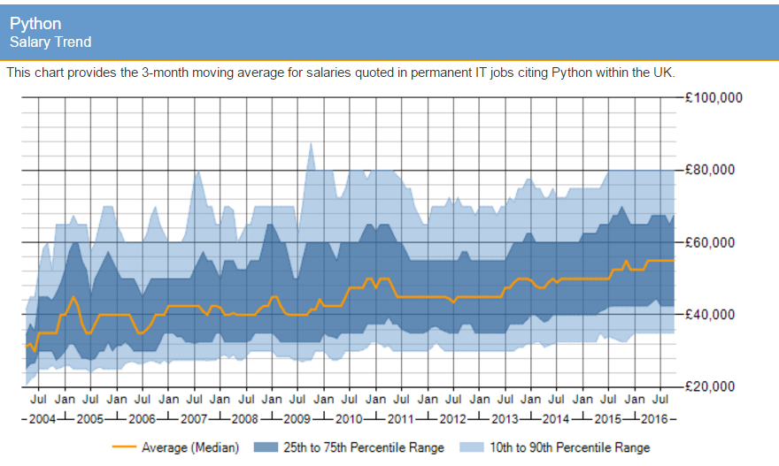
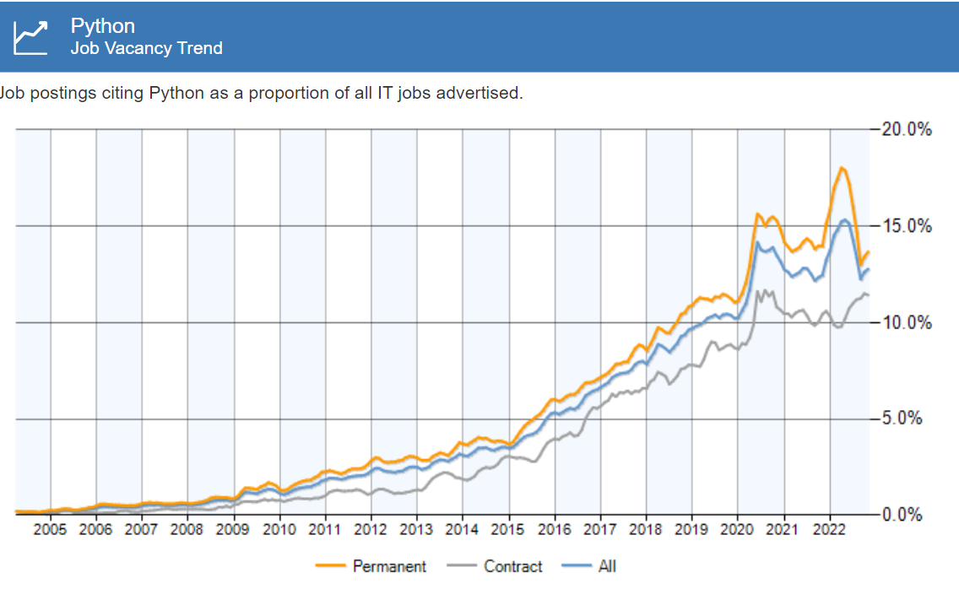

Slide 8
Course Design
Focus on programming and algorithms
Python, HTML, Javascript, Students Choice
Computational thinking at the core
Problem Solving
Design Systems
Understanding human and machine intelligence
Expanded Math’s Focus
Clear Progression
BCS, CAS and top universities.

Slide 9
The Components
01 Computer Systems
The characteristics of contemporary processors,
Input, output and storage devices
Software and software development
Exchanging data
Data types, data structures and algorithms
Legal, moral, cultural and ethical issues
02 Algorithms and Programming
Elements of computational thinking Programming and problem solving
Pattern recognition, abstraction and decomposition
Algorithm design and efficiency
Standard algorithms.
03 Programming Project
Analysis
Design
Implement
Evaluation

Slide 10
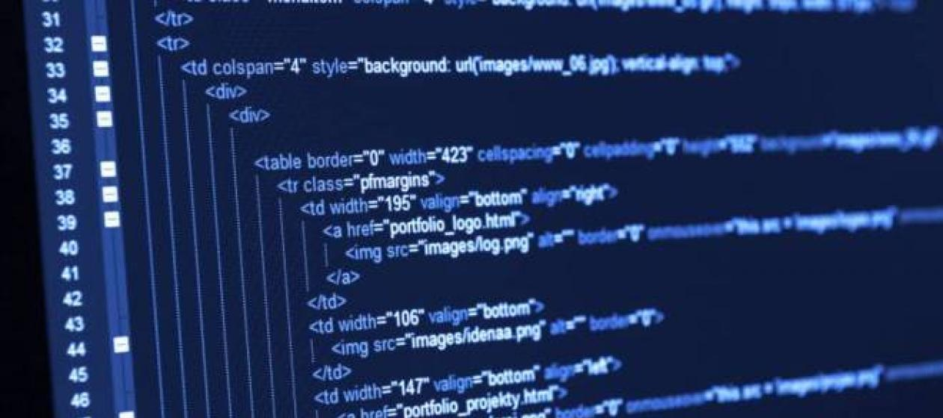
Assessment
Component | Method | Marks
01 Computer Systems | Question Paper – 40% | 140 Marks/ 2Hrs 30Min
02 Algorithms and Programming | Question Paper – 40% | 140 Marks/ 2Hrs 30Min
03 Programming Project | Project – 20% | 70 Marks

Slide 11
Course Requirements
Course Designed to build on GCSE
With the novice in mind
4/5 Grades in Computer Science
M2 in Cambridge Nationals in IT
GCSE grade 5 or above in English and Maths

Slide 12
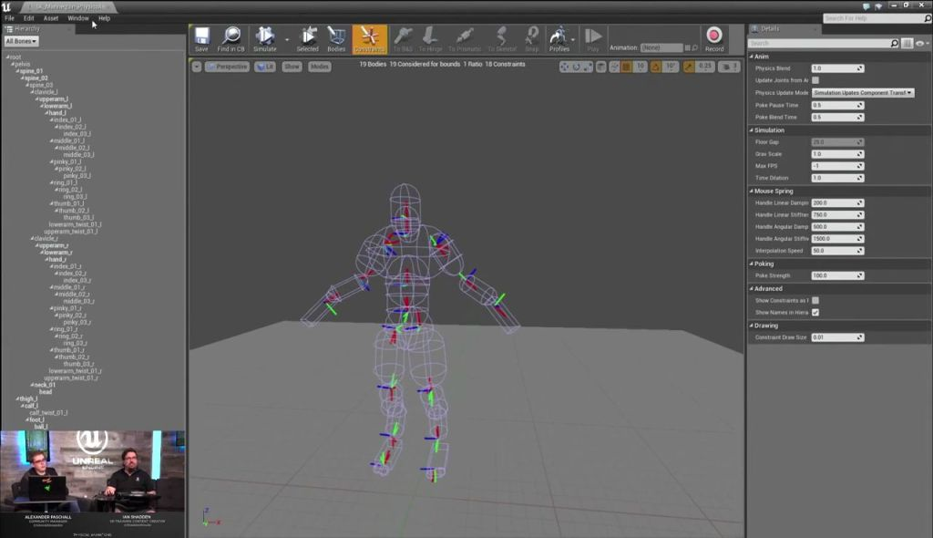
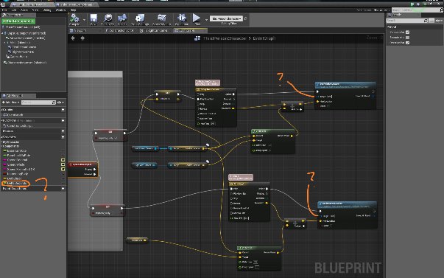
Progression
Big Data Analytics
Computer Science
Database Professional
Games Software Development
Business information Systems
Business and ICT
Web and Cloud Computing
Enterprise Systems
Artificial Intelligence
Software Engineer
Scientist
Engineer

Slide 13
Outcomes

