Slide 1
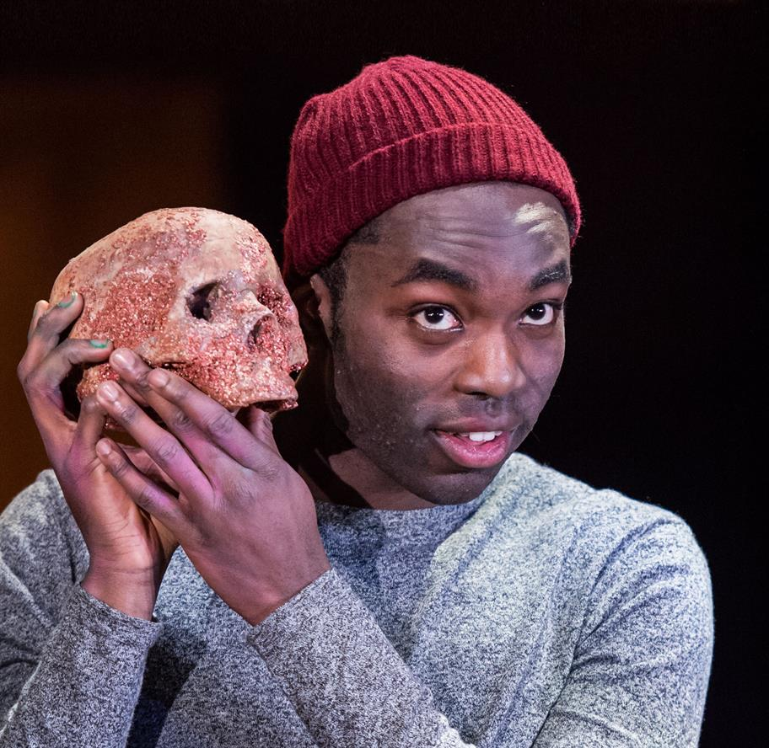
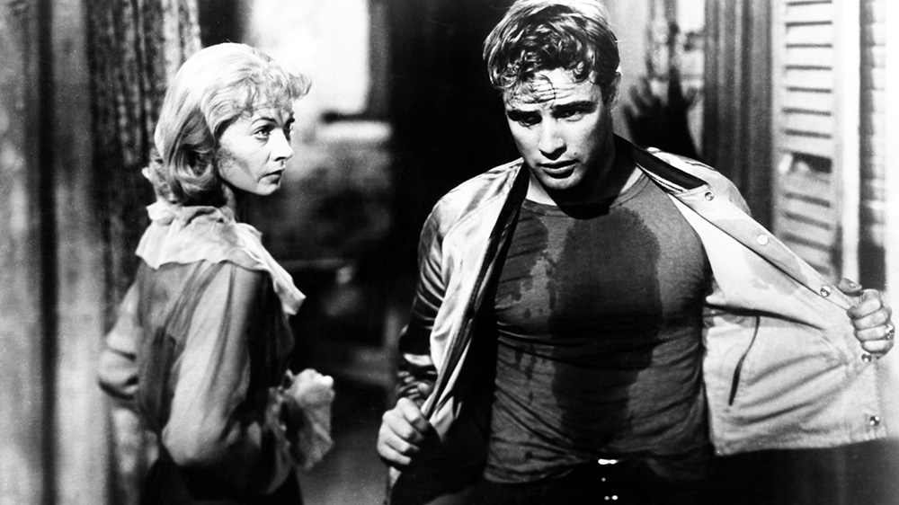
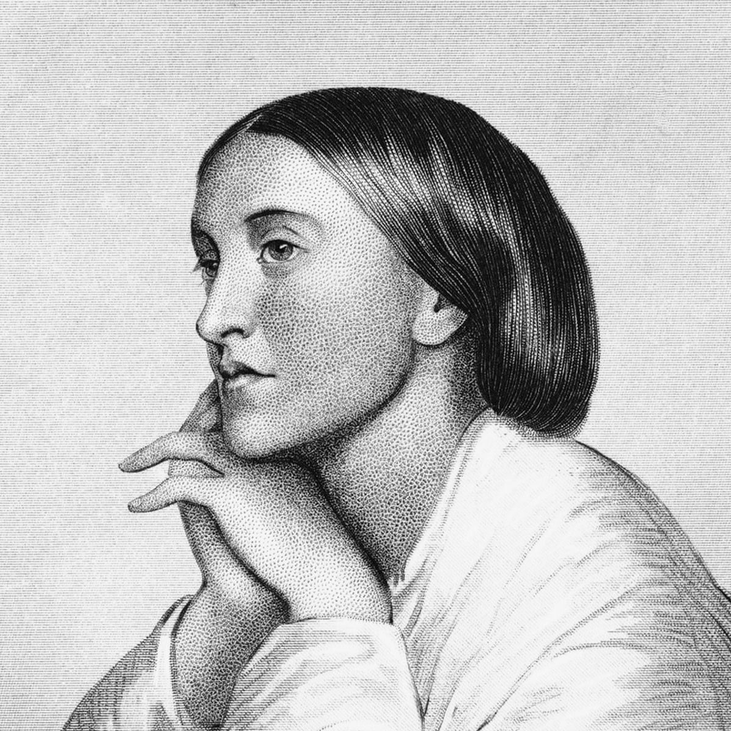
English Literature
at Honiton Community College

Slide 2
Why Study English Literature at A Level?
For voracious readers, word lovers, poets, and theatre buffs English Literature is the perfect choice.
Studying Literature allows us to share the experiences of others and take on new perspectives. These are shaped by exploring and challenging ideas, beliefs, and values that may differ from your own.

Slide 3
Why Study English Literature at A Level?
Literature can also be a great comfort, promoting acceptance of feelings, but additionally teaching us shades of right and wrong. It can make us feel a little less alone, when we need the familiarity of a friend in the absence of others.
Importantly, you will learn the necessary literary skills to express yourself in original and creative ways through dialogue, debate, argument, prose, and poetry. Literature can undeniably encourage us to find that voice deep within that refuses to be silenced but is also desperate for a safe outlet, and English provides that for us all.

Slide 4
General Information
Entry Requirements:
Students need to have achieved a GCSE Grade 5 or above in both English Literature and English Language.
Exam Board: OCR
We proudly teach diverse texts at Honiton Community College and feel privileged to offer students access to a range of literature that will not only help develop their skills, knowledge, and understanding of the subject, but also provide an opportunity to engage with work that is more relevant to their own lives and those around them.

Slide 5
OCR A Level: Course Outline
Component 1: Drama and Poetry Pre-1900
Section A: Hamlet
Section B: Rossetti poetry and A Doll’s House by Henrik Ibsen
Closed Text / Written Paper / 60 marks / 2 hours 30 minutes / 40%

Slide 6
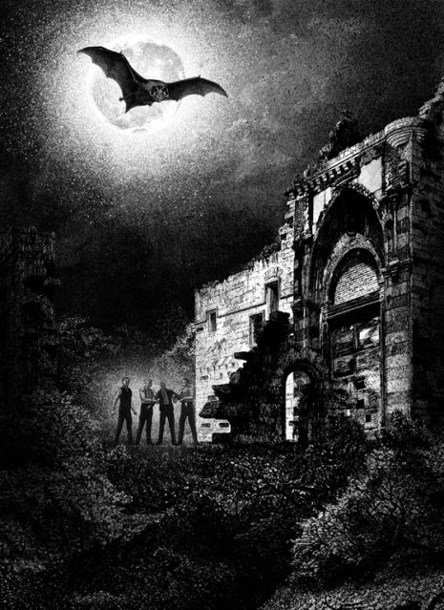
OCR A Level: Course Outline
Component 2: Comparative and Contextual Study
Critical Appreciation: Gothic
(The Bloody Chamber and Dracula)
Closed Text / Written Paper / 60 marks / 2 hours 30 minutes / 40%

Slide 7
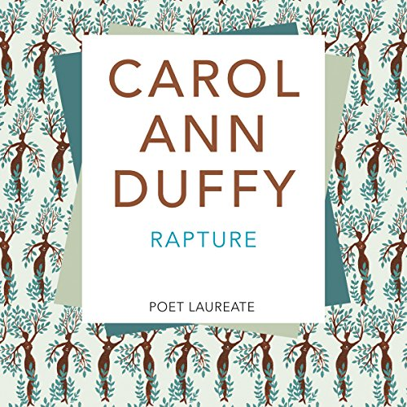
OCR A Level: Course Outline
Component 3: Non-Examined Assessment
1) Close Reading: Carol Ann Duffy Poetry - Rapture
2) Comparative Essay: James Baldwin – If Beale Street Could Talk & Tennessee Williams – A Streetcar Named Desire
40 marks / 20% of the A-Level

Slide 8
What does English Literature look like at HCC?
A Level students at Honiton Community College will:
Read with breadth and depth - both set texts and a range of guided wider reading
Engage critically and creatively with a substantial body of texts and ways of responding to them
Develop and effectively apply their knowledge of literary analysis and evaluation in writing
Explore the contexts of the texts they are reading and others’ interpretations of them.
Develop the critical skills essential for under-graduate study.

Slide 9
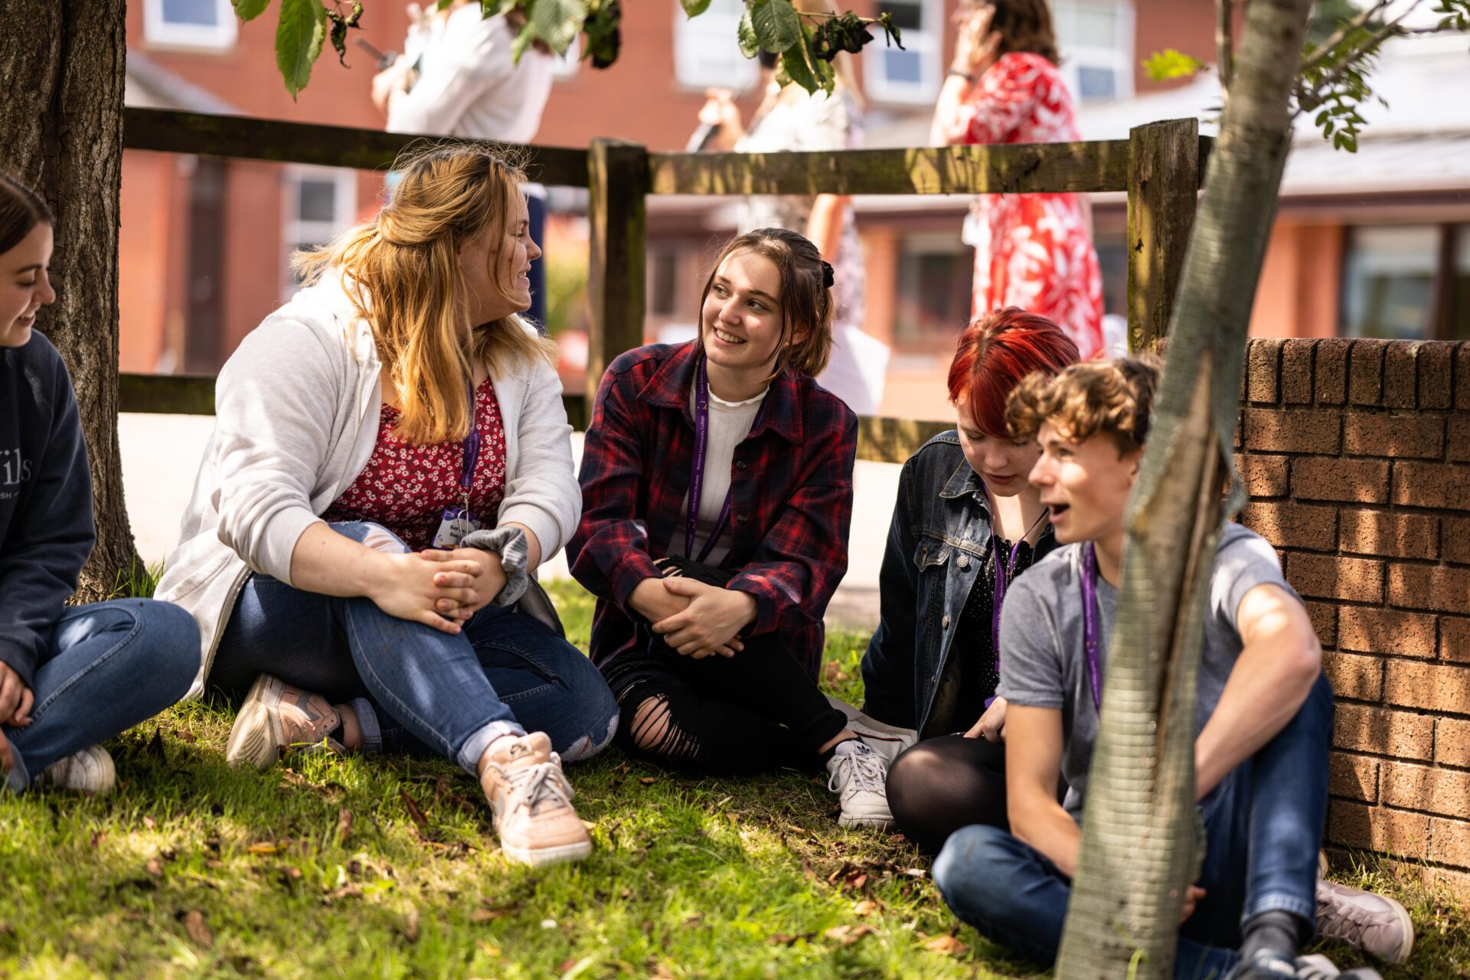
Why HCC?
Small groups allow for more personalised learning, tailored to individual needs
Experienced teachers within the department
Excellent, engaging and enjoyable course (OCR)
We are a community – extremely well supported inside and outside the classroom
Post-16 Centre - dedicated area for you to work independently in a unique learning and social environment. (It also has an equipped kitchen area for light snacks to be prepared, and IT facilities for you alone to use).

