Slide 1
Algorithms
“Don’t be scared. Universities love Further Maths.” Callum Bauer, Year 13

Slide 2
Proof by Induction
$$1+2+3+…+n=\frac{1}{2}n(n+1)$$

Slide 3
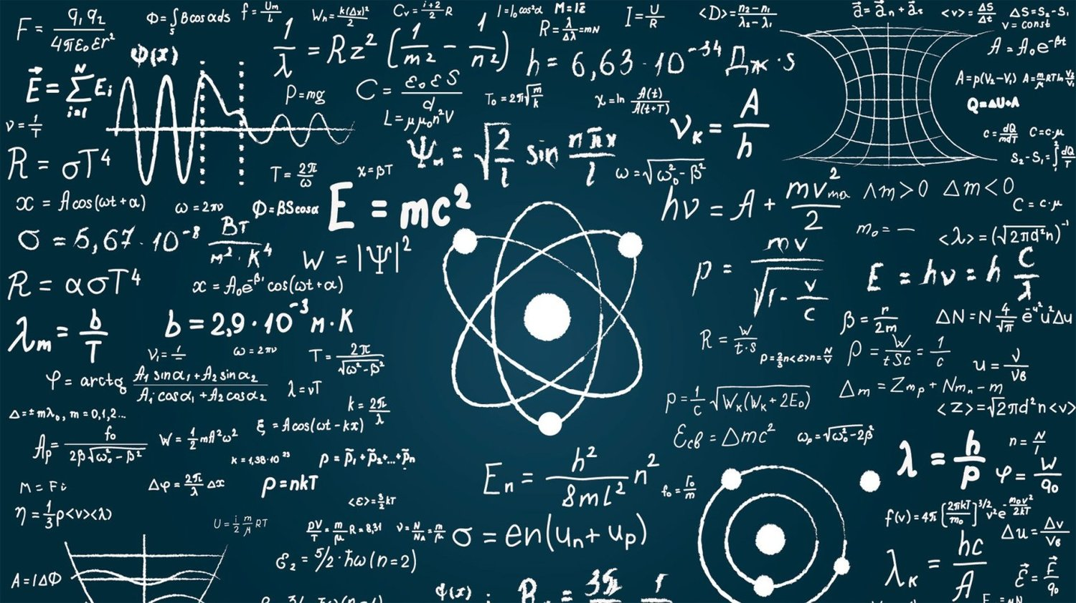
Matrices
$$3x+6y+2z=5$$
$$6x+4y+5z=9$$
$$2x+7y+8z=7$$
$$\left(\begin{matrix}x \\ y \\ z\end{matrix}\right) ={\left(\begin{matrix}3 & 6 & 2 \\ 6 & 4 & 5 \\ 2 & 7 & 8\end{matrix}\right)}^{−1}\left(\begin{matrix}5 \\ 9 \\ 7\end{matrix}\right)$$

Slide 4
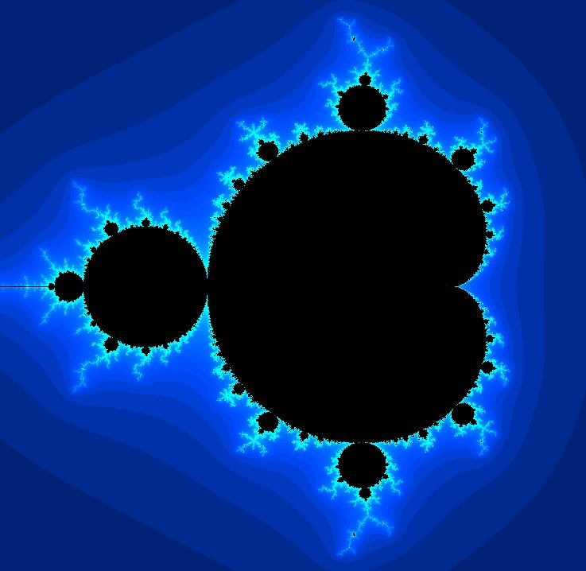
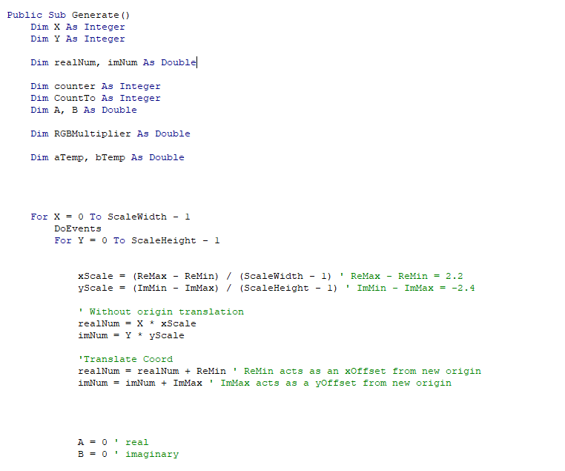
Complex numbers $$z^{2}+1=0$$

