Slide 1
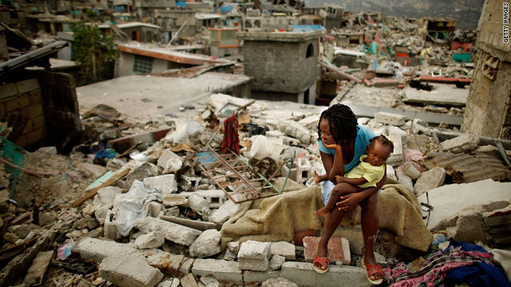
Entry requirements
Grade 5 or above in English Language. Being able to write in an articulate, academic style is crucial to answering A Level Geography questions.
Grade 5 in GCSE Geography. Students that achieve below this grade will struggle with the academic rigour of the subject.
“Studying A levels at HCC has allowed me to develop my skills as an independent learner, in an environment that I know, with teachers who really know me as an individual”. Year 12 student 2018
An interest in global issues and how people interact with the planet is important. A desire to understand the world beyond UK shores will make the course more enjoyable. Wanting to know how the world works will make finding out easier.
Exam question: Assess the extent to which cultural diffusion caused by globalisation inevitably leads to social and political tension. (20)
Notes:
A Level geography is challenging, just look at the question in the red box and a decent grade in GCSE is an essential starting point.
The ability to write comprehensively and clearly is essential, often the accuracy of an exam answer is influenced by writing style, avoiding dramatic and subjective statements is important to answering geography questions.

Slide 2
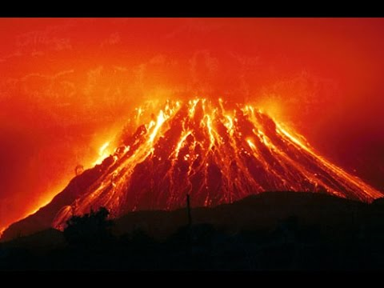
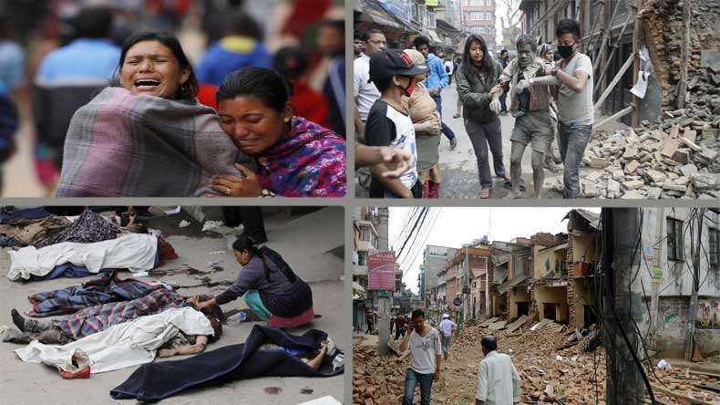
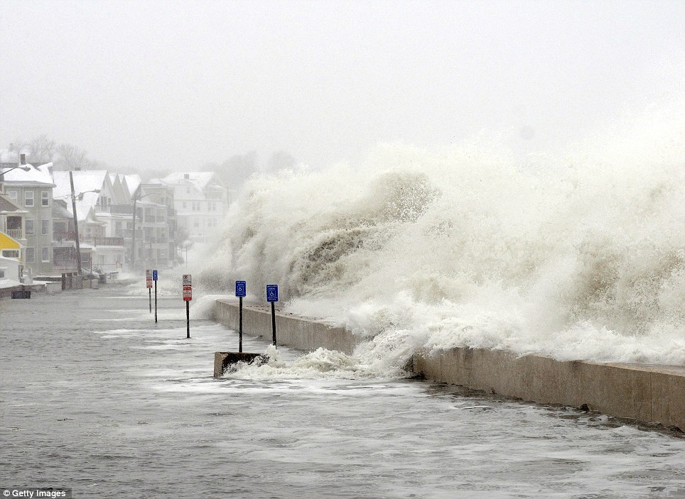
Y12 Geography
Tectonic processes and hazards
Unit One Physical Geography
Exam question:
Assess whether vulnerability and coping capacity are the most important factors in understanding the impact of tectonic disasters.
Coastal Landscapes and change
Three day residential in North Devon conducting coastal fieldwork and write up
Notes:
Miss Barnard teaches the physical and I teach the human, playing to our strengths.
Physical units in Y12 mix coasts building on what you will have learned at GCSE and tectonic processes and hazards which will be new to you.
Three days of field work will be undertaken to complete your coursework. You can choose a physical or human topic, and we may go to a field study centre or may take you our ourselves.
Tectonics: causes, responses and impacts. Coasts: How our coastlines are changing and the impact people are having on coastal environments.

Slide 3
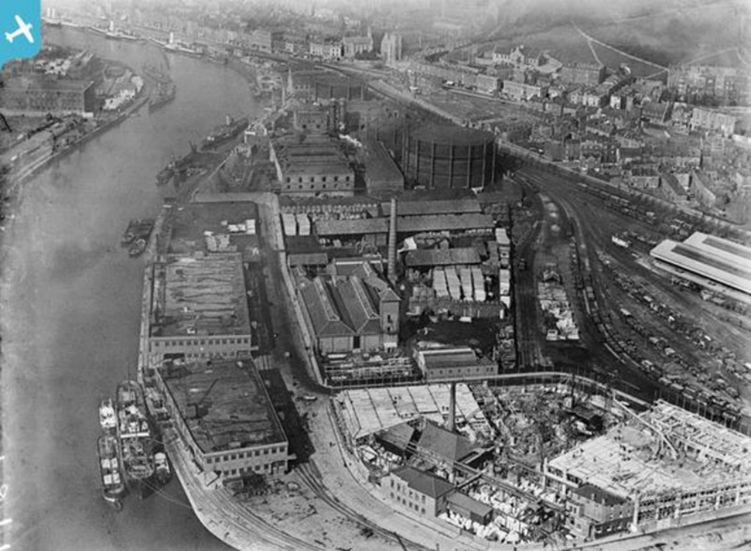
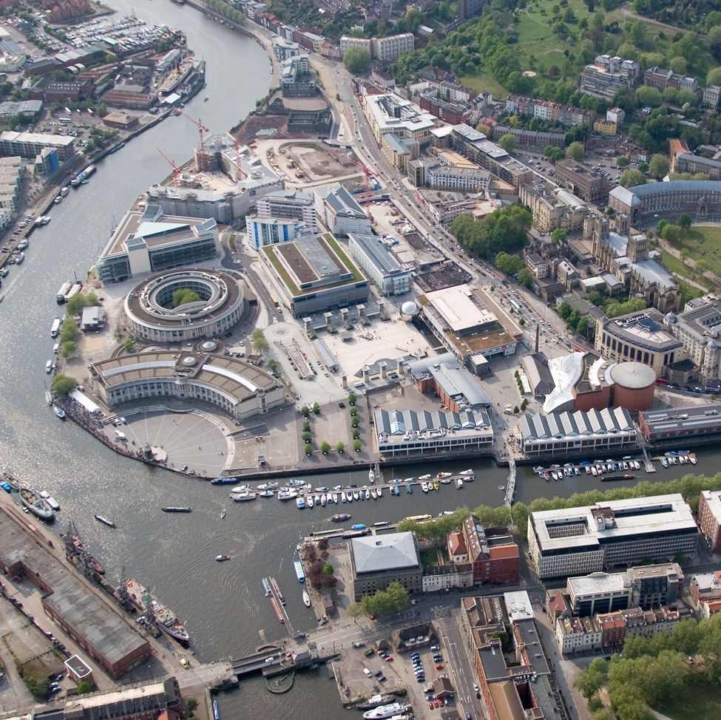
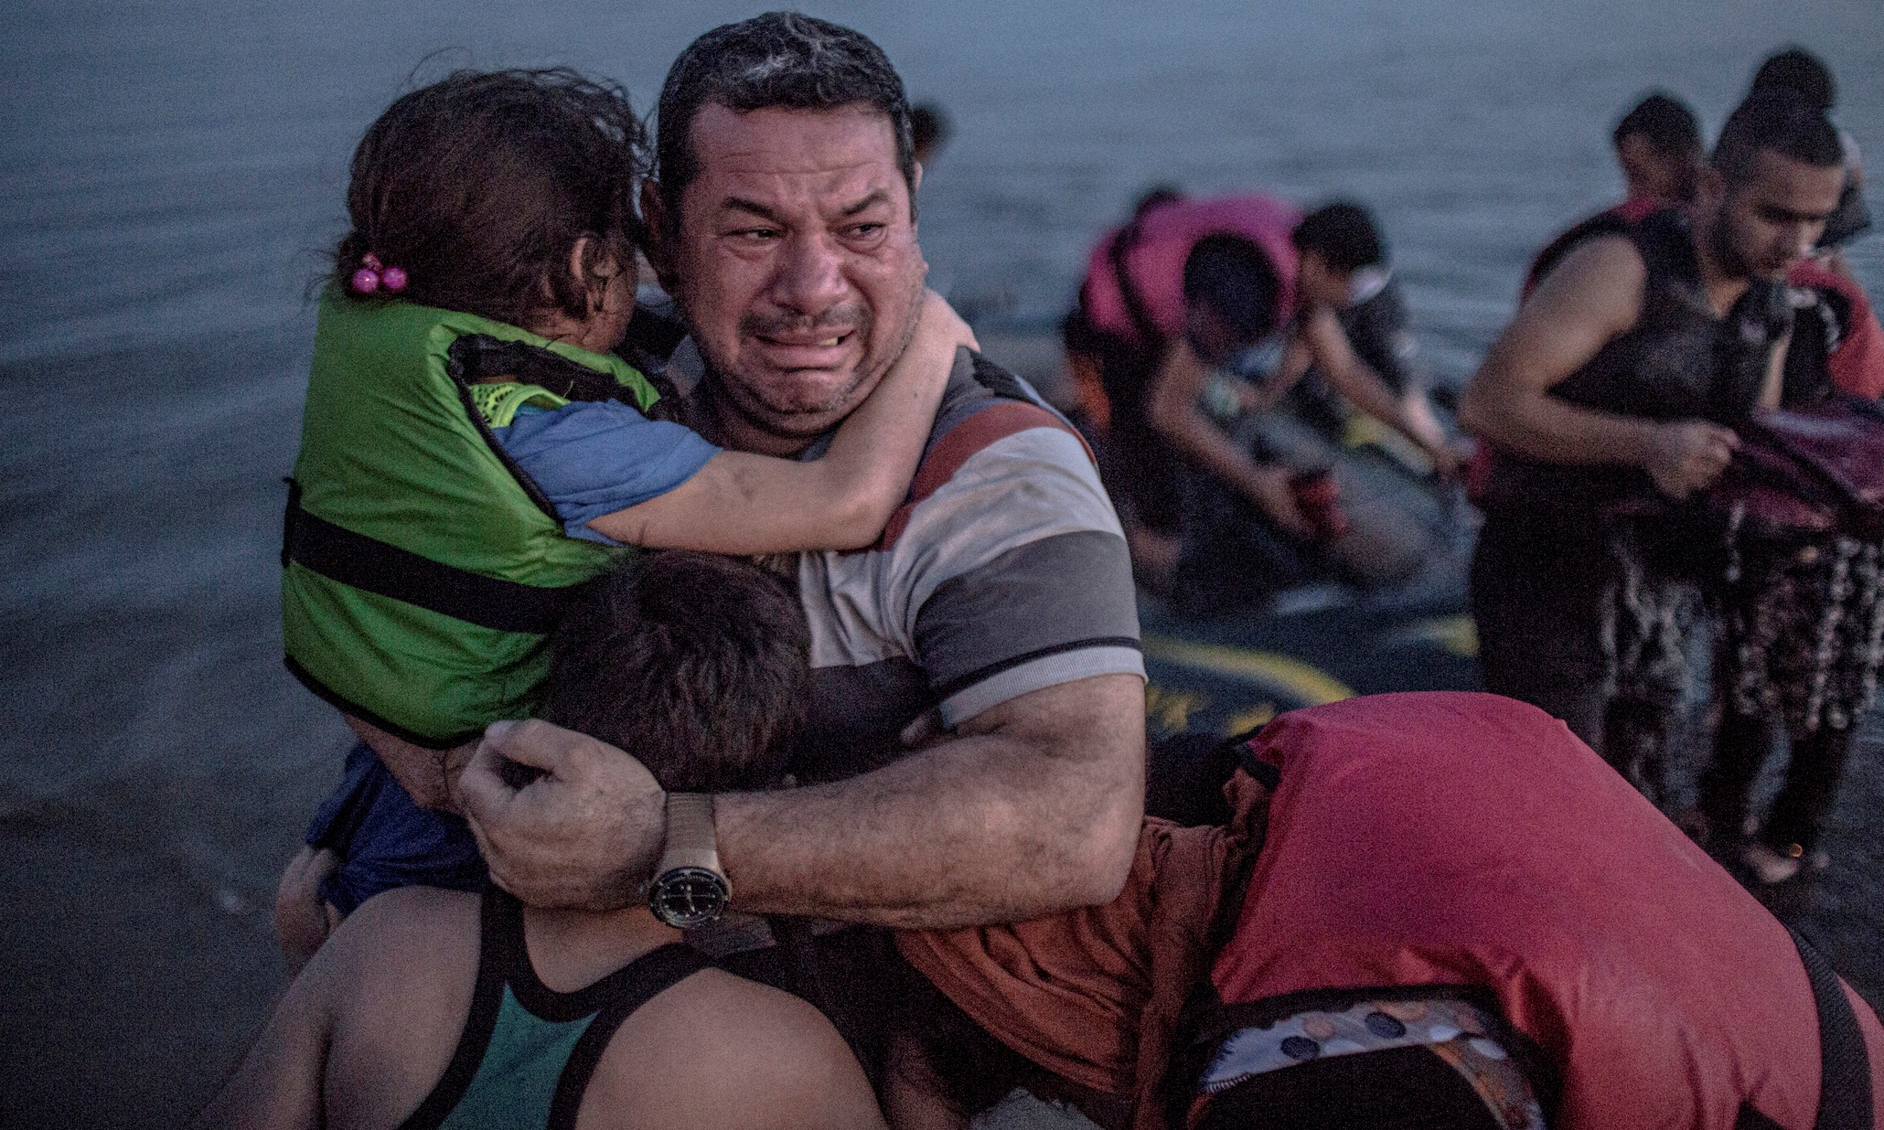
Y12 Geography
Regenerating Places
Globalisation
Unit Two Human Geography
Notes:
Human topics in Y12 are globalisation and regenerating places, most of this will be new to you but references are made throughout to content you’ve studied at GCSE in changing cities and global development.
Globalisation: How and why is globalisation accelerating? Who benefits and who loses out? What ethical questions does it raise?

Slide 4
Where will A Level Geography take you?
Skills: Collecting information from real situations. Analysing and interpreting data. Looking at issues critically and impartially. Presenting data to others. Essay and report writing. Decision making.
A ‘facilitating subject’. These are subjects that most frequently required for entry to degree courses, these subjects open up a wide range of options for university study. If you’re not entirely sure what you want to study at degree level these subjects are crucial.
Degrees and employment: The study of natural environments is an excellent foundation for employment or study in the area of environmental management or resource exploitation. The human geography provides a superb background to areas related to economics and business, urban planning, development and global finance.
Notes:
Geography is a ‘facilitator subject’, please take time to find out what this is and its implications on university applications before you choose you A Level options. The skills are easily transferable. A Level geography is not vocational, but provides access to a wide range of degree course. Have a look at some university courses you may be interested in before choosing you’re a Levels.

Slide 5
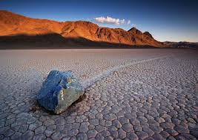
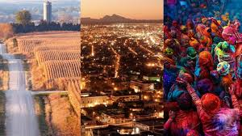
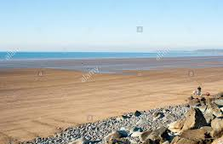
ASSESSMENT
Paper 1 – Physical Geography Sections A and B 30%
Paper 2 – Human Geography Sections A and B 30%
Paper 3 – Synoptic investigation answer all question. 20%
Paper 4 – Independent investigation (coursework) 20%
Notes:
Paper 1 and 2 speak for themselves.
Paper 3 draws on human and physical geography and applies this to a specific global issue.
Your coursework is the final component and is internally marked and externally moderated.

