Slide 1
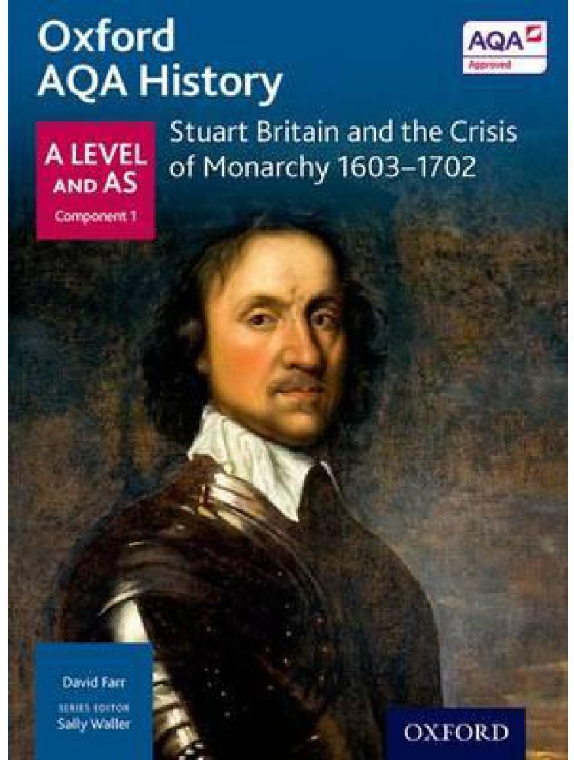
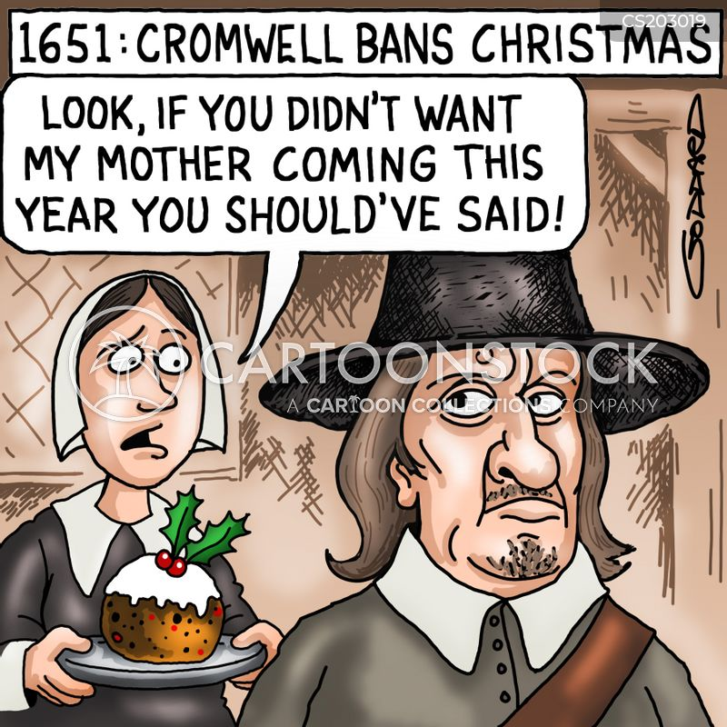
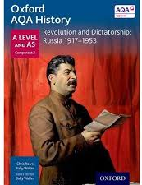
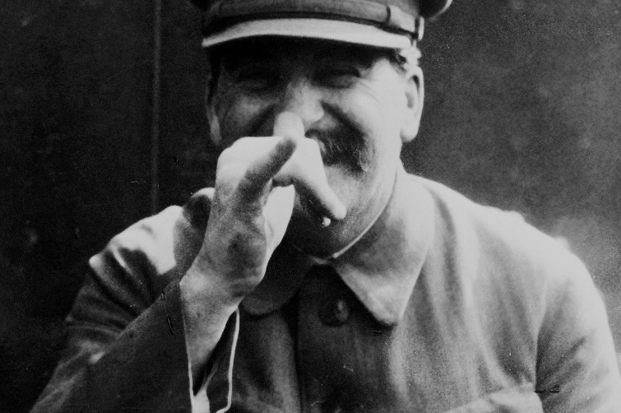
AQA: A-Level History
Component 1: Breadth study 1D Stuart Britain and the Crisis of Monarchy, 1603-1702 (40%)
Component 2: Depth study 2N Revolution and Dictatorship: Russia, 1917-1953(40%)
Component 3: Historical investigation NEA (personal study) (20%)
Notes:
Who
Looking for engaged students who have a passion for History & who enjoy arguing their point of view.
Grade reqs: 5 in History, 5 in English
Literacy and writing proficiency
Why
One of the most desirable A Level subjects by top Universities.
Highly regarded by employers (critical thinking skills, good communication, expertise in independent research)
Students who specialise in History can go on to careers in journalism, law, curation, teaching, editing, politics, social work

Slide 2
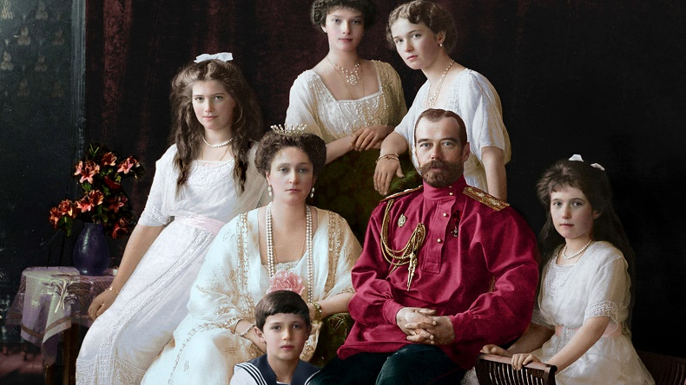
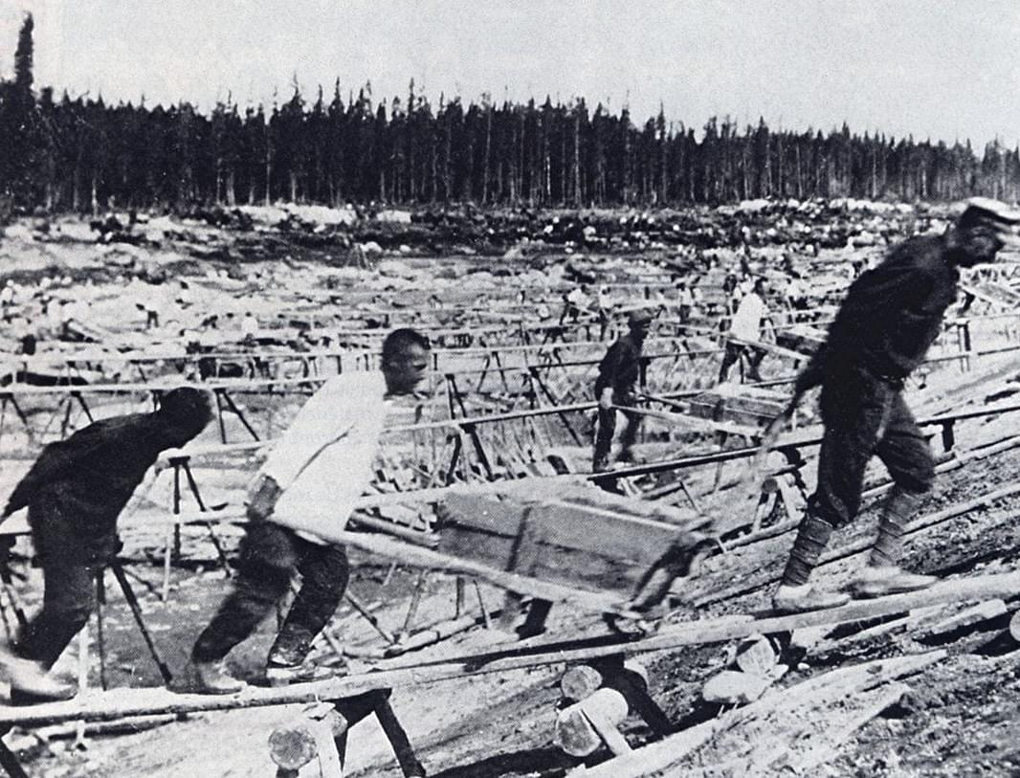
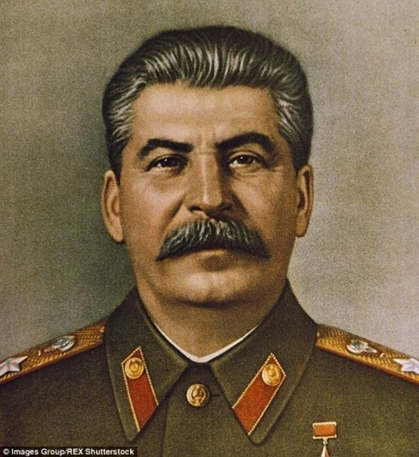
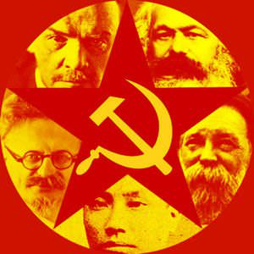
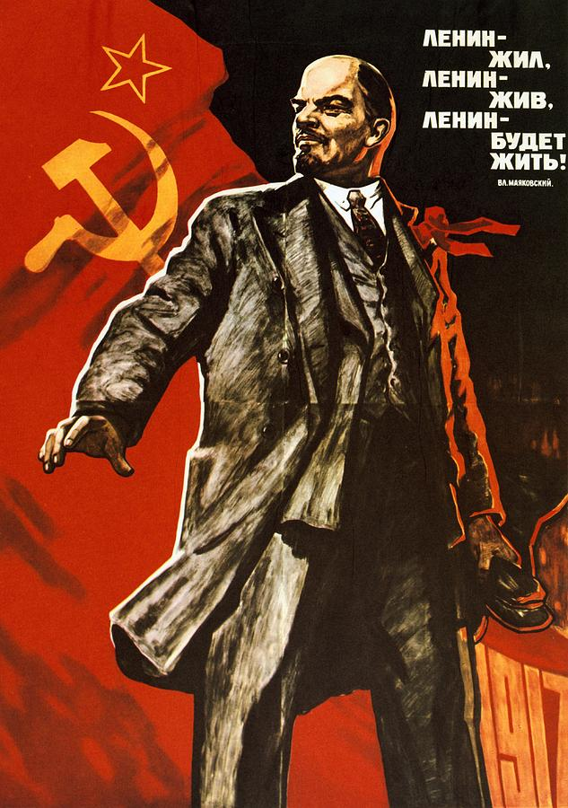
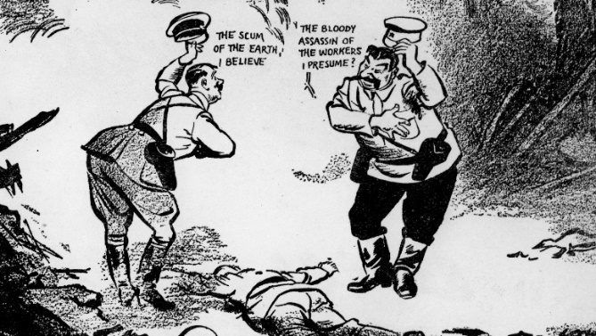
Component 2: Depth study 2N Revolution and Dictatorship: Russia 1917-1953
What were the consequences of Stalin’s paranoia?
The revolutions of 1917: people power or political outmanoeuvring?
How did three centuries of autocracy crumble so swiftly?
How did Russia push back from the brink of failure to emerge from WWII as a superpower?
Why was Lenin idolised and adored?
Notes:
Power struggle
Ties with understanding Russia in the 21st century and conflict in Ukraine
Sources

Slide 3
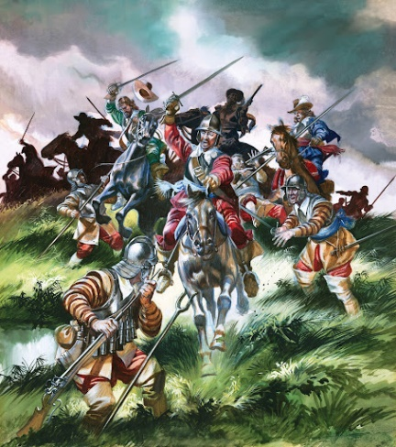
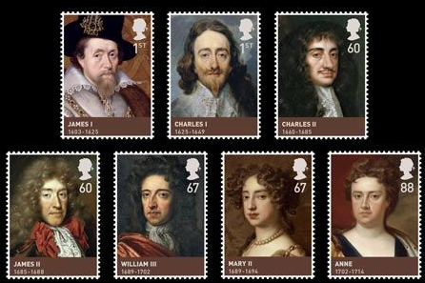
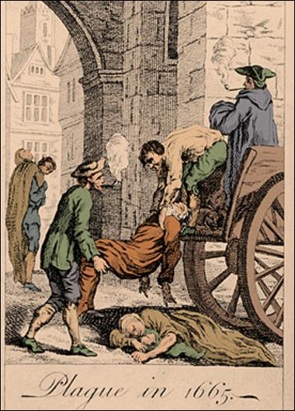
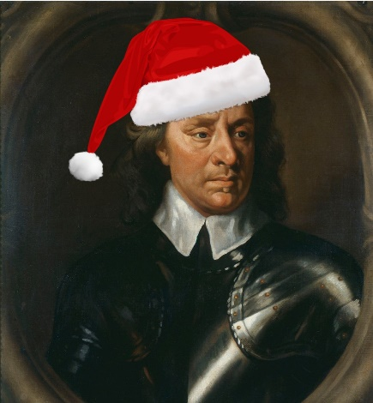
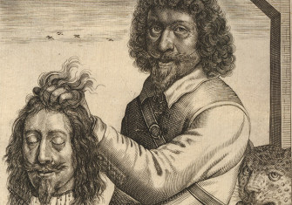
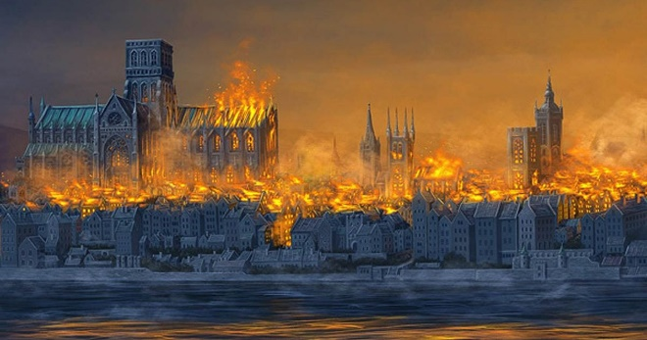
Component 1: Breadth study 1D Stuart Britain and the Crisis of Monarchy, 1603-1702
How did England respond to the collapse of the Tudor dynasty?
How do you recover financially, politically and ideologically from upheaval at the top?
Gruesome conflicts; a raging pandemic and the most famous fire in British History – how did England cope?
What do you do without a monarchy?
How do you behead a king?
Notes:
Social history
Turmoil – century of ‘crisis’
Interpretations

Slide 4
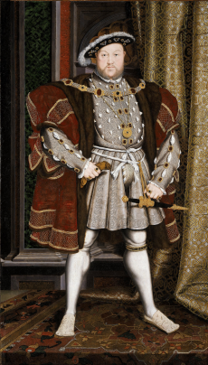
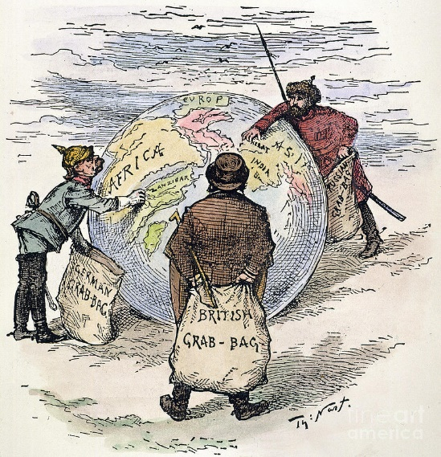
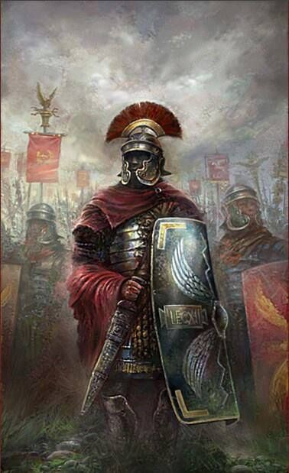
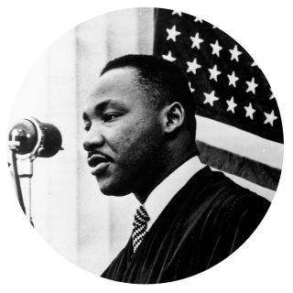
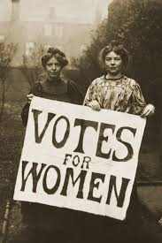
Component 3: Historical investigation NEA (personal study)
At Honiton we are able to offer a bespoke package of support for each student which allows them to choose their own area of interest to study.
Notes:
Could be linked to future career (e.g. law, politics, social reform, etc.)
Could be linked to university courses (e.g. the 20th century world, ancient realms, the Renaissance)
Mini-NEA project to develop skills in Y12

