Slide 1
L3 Cambridge Technicals Information Technology
Extended Certificate
Introductory Diploma
Overview

Slide 2
“Britain has seen an exponential growth in digital innovation, but the shortage of digital skills is threatening to derail the UK’s position as a dominant force in IT. The UK, at any one time, is facing a shortfall of around 40,000 people with the necessary STEM skills to meet the demand of the digital economy.
The British Chamber of Commerce released a study last year which highlighted that 75 percent of UK businesses reported a digital skills shortage in their employee base.”
“Having the right digital skills is not only essential for employers, it also has significant benefits for workers. Our research shows that having specific digital skills, such as search engine optimisation for marketers, workers can reduce their risk of automation by a dramatic 59%. Digital skills also carry a large wage premium. Overall, roles requiring digital skills pay 29% (£8,300) over those roles that do not (£37,000 vs £28,700) with the premium increasing at higher skill levels.”
(Margot James, Minister for Digital and the Creative Industries June 19) (https://www.gov.uk/government/publications/current-and-future-demand-for-digital-skills-in-the-workplace)

Slide 4
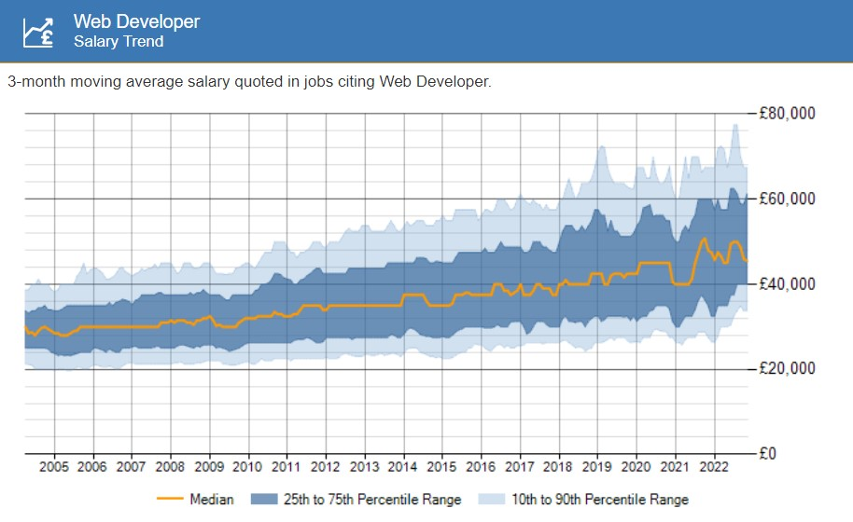

Slide 5
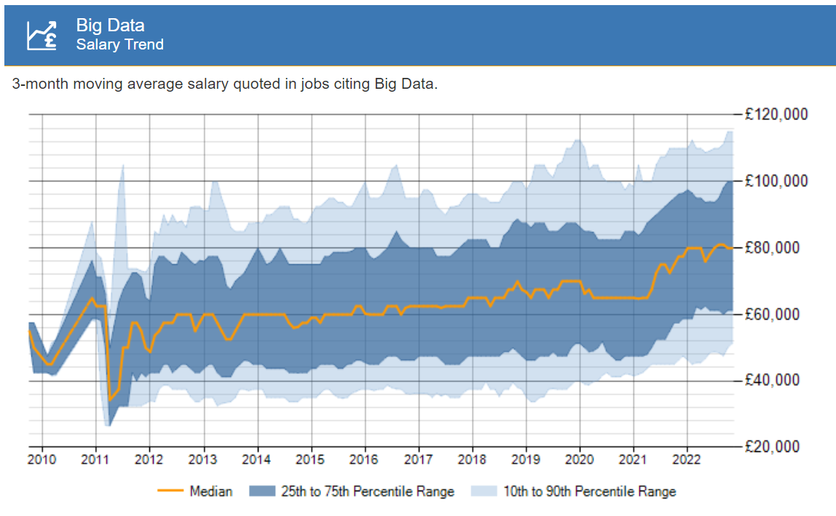

Slide 6
Practical
Refreshing and up to date
Problem Solving for the 21st Century
Crosses Subject Boundaries
Arts, Maths, Humanities
Principles of IT and Global Information Systems
Vocationally Related

Slide 7
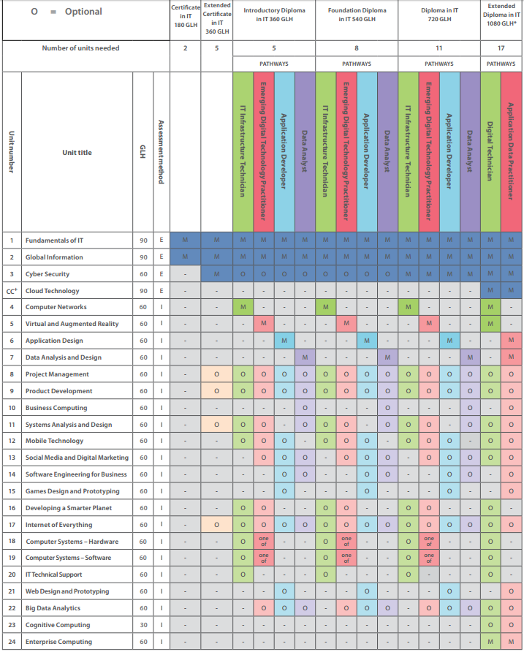
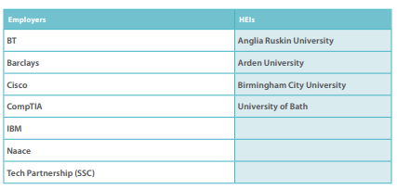
Course Design
Core Pathways
IT Infrastructure Technician
Emerging Digital Technology Practitioner
Application Developer
Data Analyst
Core Units
Fundamentals of IT
Global Information
20 Optional Units
Clear Progression
Top universities and employers demand

Slide 8
1 Fundamentals of IT
2 Global information
3 Cyber security
4 Computer networks
5 Virtual and augmented reality
6 Application design
7 Data analysis and design
8 Project management
9 Product development
10 Business computing
11 Systems analysis and design
12 Mobile technology
13 Social media and digital marketing
14 Software engineering for business
15 Games design and prototyping
16 Developing a Smarter Planet
17 Internet of Everything
18 Computer systems – hardware
19 Computer systems – software
20 IT technical support
21 Web design and prototyping
22 Big Data analytics
UNITS

Slide 9
Assessment
Component | Method | Marks
U1 Fundamentals of IT | Question Paper – 25% | 80 Marks/ 1Hr 30
U2 Global Information | Question Paper – 25% | 80 Marks/1Hr 30
U3 -22 Project 1 Project 2 Project 3 | 3 Portfolios – 50% | Pass 14 Merit 16 Distinction 18

Slide 10
Course Requirements
Course designed to build on iMedia and CS
With the novice in mind
M2 in Cambridge Nationals in ICT
Grade 4/5 in Computer Science

Slide 11
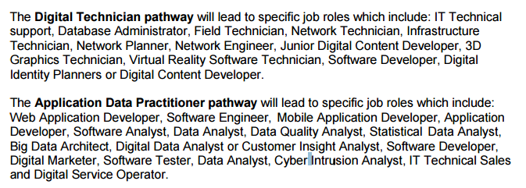
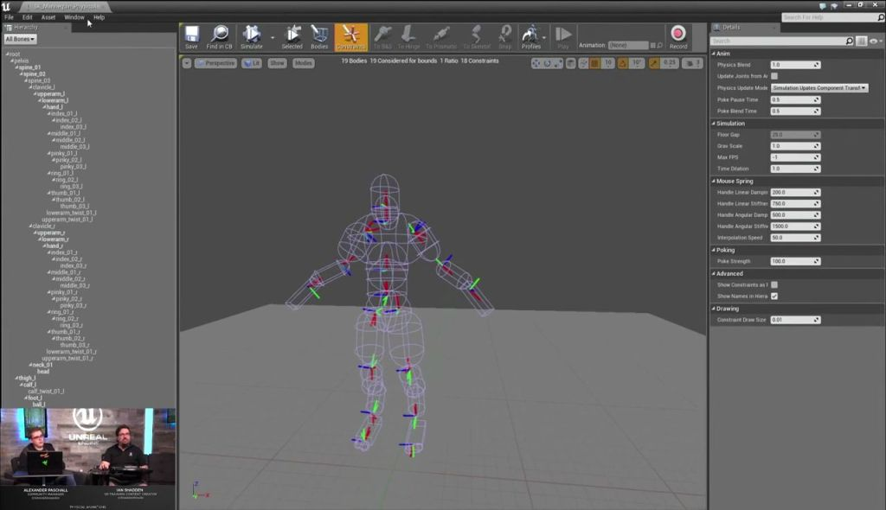
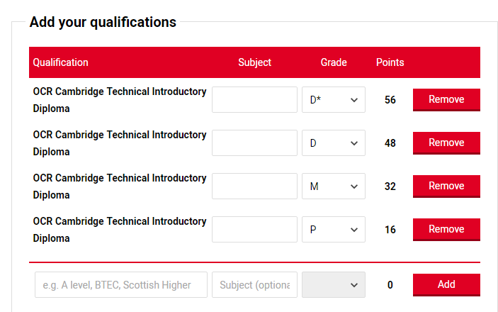
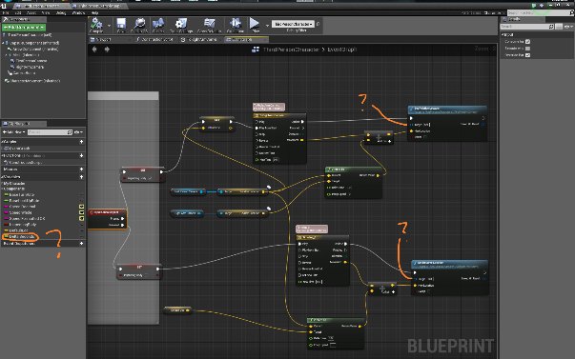
Progression

