Slide 1
Physics A-level

Slide 2
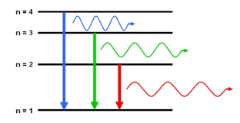
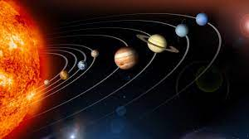
What does the course involve?
Year 12
Forces
Particle Physics
Waves & quantum effects
Electricity
Materials science
Year 13
Fields
Harmonic motion
Thermal Physics
Radioactivity
Choice of: Astrophysics, Engineering physics, Medical Physics, Turning points
Thinking. Applying what you know to the real world

Slide 3
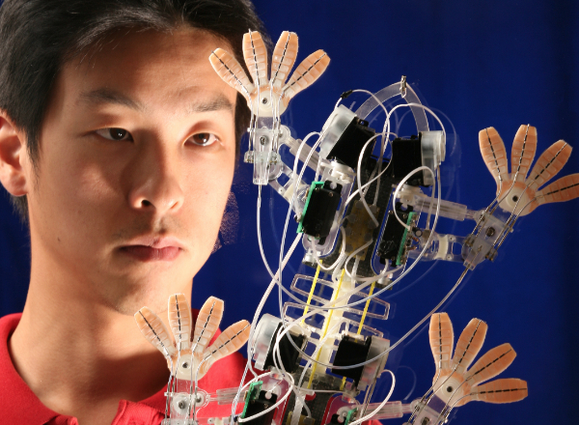
Why should you consider taking it
Because you want to invent something new and undiscovered
Because you love Maths and applying Maths to solve real world issues is something you would enjoy
Because you want to go into finance and make money
Because you love programming and want to be able to model the real world
Because you want to know how the world / universe works
Because you want to solve the energy crisis and save the planet
Because you want to be one of the most employable people you can imagine
Because you love taking things apart to see how they work
Because you’re good at it.

Slide 4
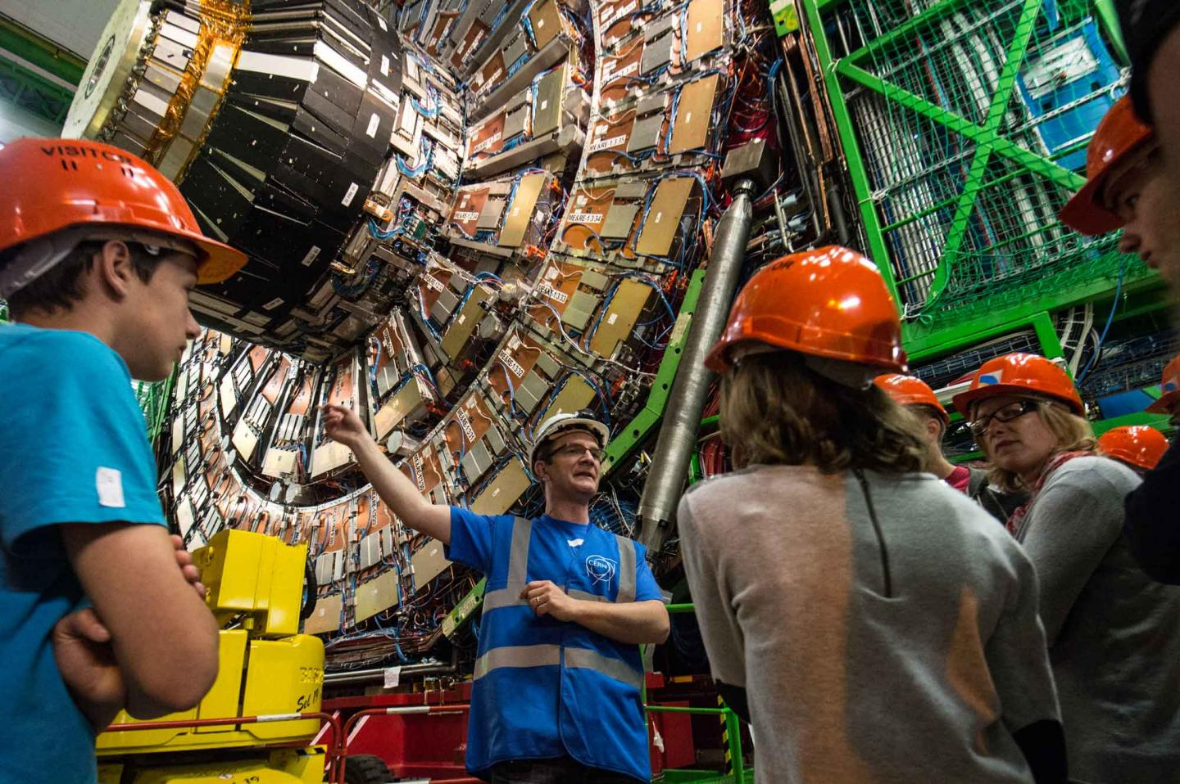
What it can lead to
Research Scientist
Computer programmer
Meteorology / Climate
Finance industry
Radiology / medical
Engineering
Geophysics
Astronomer
Inventor / Own business

Slide 5
Who is the course suited to.
YES
NO
Like to apply what I know to the real world
Think carefully about things
Pretty good at Maths and like it (Level 6+)
I persevere and don’t “let things go”
Inquisitive
Pretty good at GCSE (level 6+) and enjoy it
I don’t like Maths
I don’t think about how things are made or why things happen
Choosing it because I don’t know what else to do

Slide 6
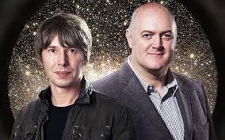
Other subjects that work well with Physics….
Maths
Chemistry
Biology
History
Geography
Drama
Music

Slide 7
Why HCC?
Great track record
You know the teachers
Small class sizes mean that you get 1-1 support and ask questions
Much more practical work
Closely monitored – don’t get lost in a big system
We supply the resources you need including two text books
Space to work – 6th form centre and dedicated Science rooms
You don’t need to get the train every day!
Past students have gone on to do: Astrophysics @ Exeter, Natural Science @ Cambridge, Medicine @ Southampton, Physics @ Cardiff, Maths @ Cardiff, Accountancy apprenticeship, Engineering @ Southampton, English @ Southampton (you cant win them all!)

Slide 8
Summary….
You should do Physics if you like asking questions that no-one seems to be able to answer, you enjoy Maths, you want to change the world or you want a “gateway” subject that will open doors to exiting and well paid careers.
You should do Physics HERE at HCC because we are able to offer a bespoke course which will challenge you as an individual to achieve your best, offer the best access for 1-1 support that you could possibly ask for, with great facilities, much more practical time than elsewhere and opportunities to choose the direction your studies take you.

Slide 9
And finally, there are unanswered questions still to be solved…..
What is dark matter and dark energy?
Can we colonise other planets?
Will nuclear fusion solve the problem with climate change?
Can we improve batteries to the point where electric cars are better than petrol ones?
When will computers be more intelligent than people?

