Slide 1
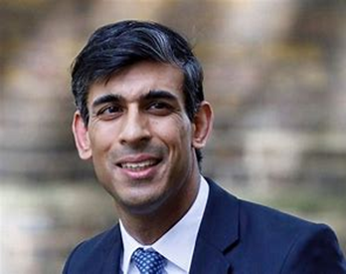
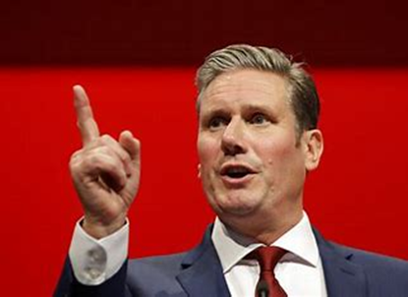
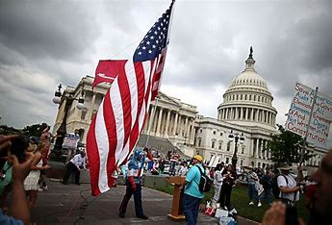
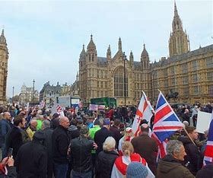
Entry requirements
AQA A Level Politics
Politics falls within the Humanities subjects. Many of the skills you from History and Geography transfer well into Politics.
Grade 5 or above in English, History or Geography. Being able to write in an articulate academic style is crucial to answering A Level Politics questions.
Lively
Relevant
Exam questions:
Explain and analyse three ways in which the media can have an influence upon the
outcome of elections.
‘Representative democracy is in crisis in the UK.’ Analyse and evaluate this statement.
Varied
Engaging
Dynamic
Controversial
An interest in politics and the world around you. An interest in keeping up to date with the politics of today in both the UK and the US.
To enable your students to show their breadth of knowledge and understanding, the exams have a simple and straightforward structure and layout, using a mixture of question styles. There will be no coursework.

Slide 2
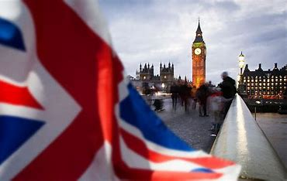
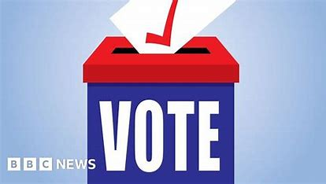
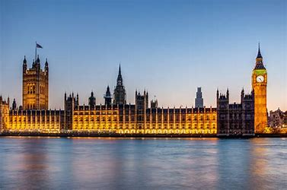
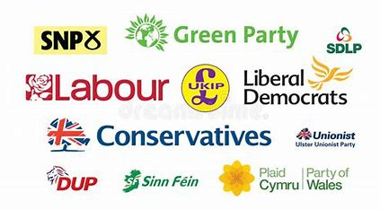
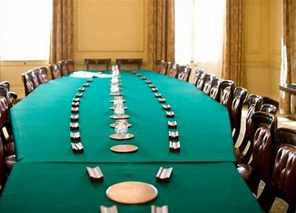
Unit 1 – Government and Politics of the UK
Elections
Democracy
British Constitution
Parliament
Pressure Groups
Prime Minister
and Cabinet
Political
Parties
Devolution
EU
Unit 3 – Political Ideologies:
Core: Liberalism, Conservatism, Socialism
Judiciary

Slide 3
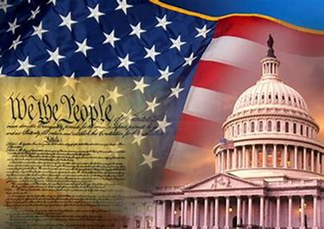
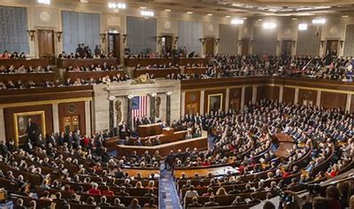
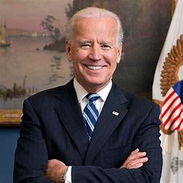
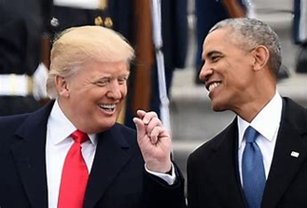
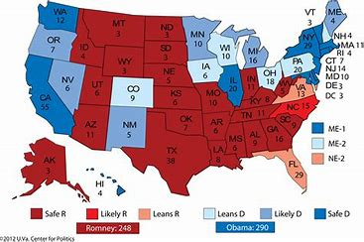
Unit 2 – Government and Politics of the US and comparative politics
Civil Rights
US
Constitution
Congress
Pressure
Groups
Presidents
Judiciary
Electoral process
Political
Parties

Slide 4
Where will A Level Politics take you?
Skills: Analysing information, evaluation of arguments, looking at evidence, reading facts and assessing fake news. Developing understanding of how the world works.
Covering news and current affairs from the UK and US, it helps you understand how the UK country is run and develops research, written communication and debate skills. It also helps grow your confidence.
Degrees and employment:
It’s ideal if you’re considering studying politics, sociology, ethics, advertising or journalism at university and is highly regarded by employers in industries including politics, international organisations, the media, government and the civil service.
A ‘facilitating subject’. These are subjects that most frequently required for entry to degree courses, these subjects open up a wide range of options for university study. If you’re not entirely sure what you want to study at degree level these subjects are crucial.

