Slide 1
A level
Psychology
Miss TAYLOR
Honiton community college

Slide 2
Do you ever find yourself asking big questions like…
Why do some people obey authority and others disobey?
What is normal?
Why can I remember some things and not others?
Why do we dream and what does it all mean?
Are we more influenced by genes or our environment?
Should we use drugs to treat mental illness or something else?
Is our destiny predetermined or do we have control over it?
Are our minds like computers?

Slide 3
Two Year A-Level
3 papers
Each paper 2 hours long
Paper 1 Introductory Topics
A: Social influence
B: Memory
C: Attachment
D: Psychopathology
Paper 2 Psychology in Context
A: Approaches
B: Biopsychology
C: Research methods
Paper 3: Issues & Options in Psychology
Each section is 24 marks.
Compulsory A: Issues and debates in Psychology
Select one B: Gender
Select one C: Schizophrenia
Select one D: Aggression
Entrance requirements
Math-5
English-5
Biology/Science-5
3
Including minimum of 10% Math's skills
Notes:
3

Slide 4
5

Slide 5
Popular psychologist’s and studies we look at in the course
Stanley Milgram -obedience

Slide 6
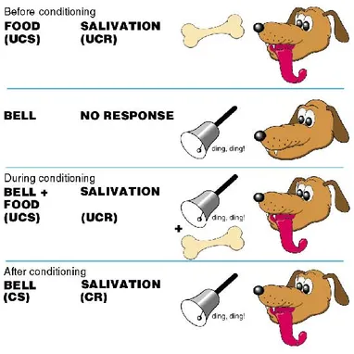
Popular psychologist’s and studies we look at in the course
Behaviourism
Pavlov's dogs

Slide 7
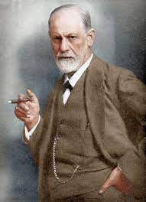
Popular psychologist’s and studies we look at in the course
Freudian theory

