Slide 1
A Level Sociology
at Honiton Community College
Miss Taylor
Miss Rew

Slide 2
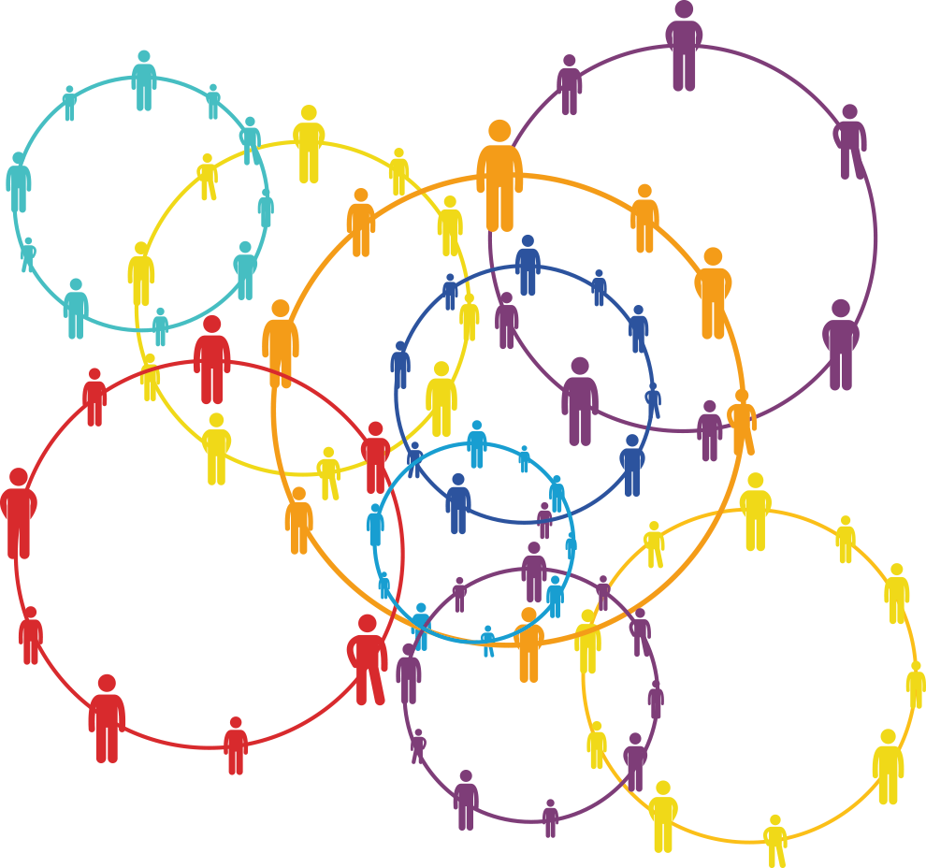
What is Sociology?
The study of society and HOW it works
Sociology will ask you to consider the following questions…
Have Facebook, Twitter and the blogsphere empowered people?
Is there an ‘ideal family’?
Why is it that factors such as class, ethnicity and gender appear to impact on how well – or otherwise – we do at school?
Why does crime occur and how reliable are official statistics?
Who has ‘power’ in society and why?
Sociology tackles contemporary issues…
Is Britain broken?
What’s the impact of social network sites?
Who do our schools benefit?
Who joins gangs?

Slide 3
Topics within sociology
Year 12
Families and Households
Education + methods in context
Year 13
Crime and Deviance
The Media
Perspectives and Research methods
Notes:
Families and households – start with this as we all come from a type – different types, role within society, changing patterns, gender roles, childhood and status of children in society, demographic changes
Education – role, functions, relationships, different achievements, research methods
Media – who owns and controls it, popular culture, how media represents society
Crime – crime, deviance, social control, who commits the crime, prevention, punishment, victims

Slide 4
Where can Sociology take you?
Possible degree options:
Sociology Criminology
Psychology
English Nursing
Journalism
Business History
Teaching
Marketing Geography
Social Work
Law Politics
Possible career options:
Social work Psychologist
Advertising
Policing Nursing
Probation
Marketing Aid worker
Advertising
Journalism SENCO
Teaching
Youth worker Lawyer

Slide 5
Assessment:
At A level there are three exams
Education and Methods in context
Families and households and the media
Crime and Deviance
These are all worth one third of your A level grade
Each exam lasts 2 hours and are worth 80 marks each
The exams consist of a mixture of short answer and extended writing questions.

Slide 6
In class assessment:
There will be a mid-unit and end of unit assessment for each topic to practice, prepare you for the assessment, ensure you have detailed feedback, and track your progress across the two years.
You will be an expert by the exam – and no surprises!
Mixture of written and practical assessment in class – e.g. in year 12 you will have the opportunity to create your own research project studying aspects of education within our school.

Slide 7
How do I know if sociology is for me?
Have a keen interest in society – what makes it work and what makes it crumble
Have a keen interest in humans – why do we act the way we do?
Inquisitive
Empathetic
Communication skills
Problem solving
Love to argue!

Slide 8
A level Sociology
We hope to see you next year

