Slide 1
SPORT & PE BTEC Level 3 National Extended Certificate in Sport
Pearson

Slide 2
Entry requirements
Desirable, but not essential, to have studied GCSE Sport Science
An interest in Sport and the theory behind the subject.

Slide 3
Course structure
4 Units
2 Assessed internally (coursework) and 2 assessed externally (exam)
Unit No. | Unit Title | GLH | Type | How Assessed | Teacher
1 | Anatomy and Physiology | 120 | Mandatory | External | ATA
2 | Fitness Training and Programming for Health, Sport and Well-being | 120 | Mandatory Synoptic | External | LRO
3 | Professional Development in the Sports Industry | 60 | Mandatory | Internal CW | PSA
4 | Sports Leadership | 60 | Optional | Internal CW | PSA

Slide 4
Assessment
The external assessment is 67% (Units 1 & 2)
The internal assessment is 33% (Units 3 & 4)
Unit | Teacher | Type | Assessment dates
Unit 1: Anatomy and Physiology | ATA | Written examination set and marked by Pearson 1.5 hours 80 marks | January Year 13 *Resit May/June if required
Unit 2: Fitness Training and Programming for Health, Sport and Well-being | LRO | Task set and marked by Pearson and completed under supervised conditions Part A – case study given 1 week before to carry out preparation (4 hours) Part B – supervised assessment 2.5 hours timetabled by Pearson Written submission 60 marks | December/January Year 13 *Resit May/June if required

Slide 5
Resources
SharePoint
Textbook
Revision guide
Revision workbook

Slide 6
Progression and career opportunities
You can progress to further study in Sport, Leisure and Physical Education
Our students go on to work and study all over the world in sectors including:
Teaching / education
Leisure management
Coaching
Physiotherapy
Sport psychology

Slide 7
University opportunities
Sports science degrees will accept this qualification.
Equivalent at A level, 56 = A*, 48 = A, 32 =C, 16 = E.

Slide 8
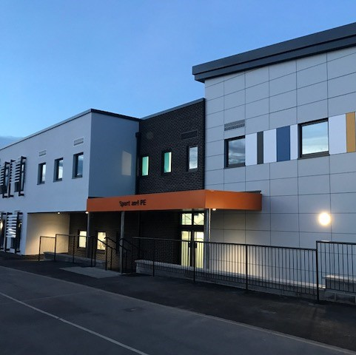
Sports Academy, Sports Leadership, P16 Sport
HCC Sports Academy
Timetabled Strength & Conditioning sessions
Nike Sports Academy kit
Training Diaries
Sports Leadership
HCC Sports Leadership
Support PE lessons & Extra-curricular Clubs
Post-16 Sport
1 session per week (optional)
Facilities

